Slide 1
Contextualizing the Africa Digital Innovation Ecosystem

Slide 2
Background - Objectives
Framing the research question
Scoping exercise; focus laid on DEFINITIONS
Definition of African Tech (ICT)-Innovation
What is African tech-innovation?
What makes African tech-Innovation different from global innovation?
Classes/categories of African Tech-Innovation
Are there different classes of African tech-innovation?
What types of innovations are prevalent in Africa?
Outlining the African Digital Ecosystem
Interacting sub-systems
Policy levers/stakeholders

Slide 3
Research Design & Methodology
Surveys
Sample frame was purposive and non-probabilistic
Sample frame driven by a stakeholder analysis (Mitchell Framework)
Semi-structured questionnaire
Exploratory Case Studies
National, regional & continental representation
Choice of countries was driven by Country Analysis
Systems Analysis
Engineering Systems Theory (Sussman)
Innovation Systems Theory – Sectoral Innovation Systems (Malerba)
Ecosystem Theory – ICT Ecosystem (Fransman)

Slide 4
Findings
During the assessment several facts about technology innovation in Africa were identified. Key among them:
Majority of the innovations were user-driven (grassroots)
Innovation was incremental (evolutionary) and frugal
Innovation resulted from applied (market pull) research as opposed to core (technology push) research
Systemic challenges
The potential has not been properly translated into tangible and significant output (system efficiency)
Many of innovations therefore only remained as hidden innovations, due to particular challenges on scaling, technology transfer as well as diffusion and adoption of innovation.

Slide 5
“But we need to make a choice: do we pursue personal achievement or collective prosperity?”

Slide 6
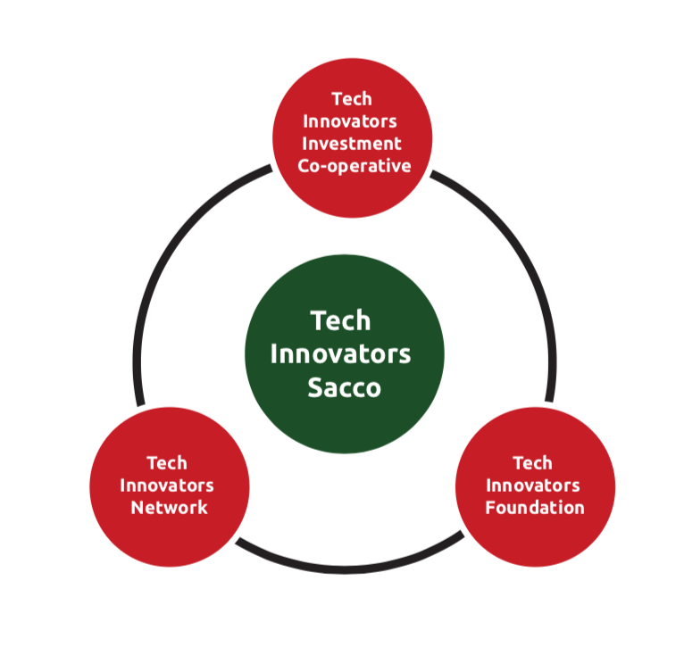
The Solution: Co-operatives
Mission - To be a collective platform for pooling financial resources and tech talent with the aim of enabling local innovation and supporting the local tech sector
Vision - To be the primary source of capital both individual and corporate within the tech sector

Slide 7
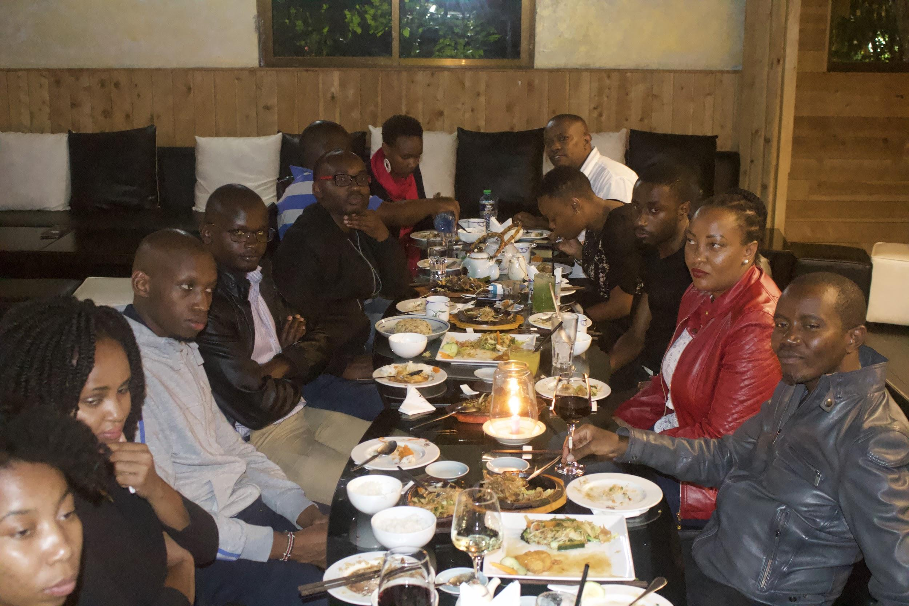
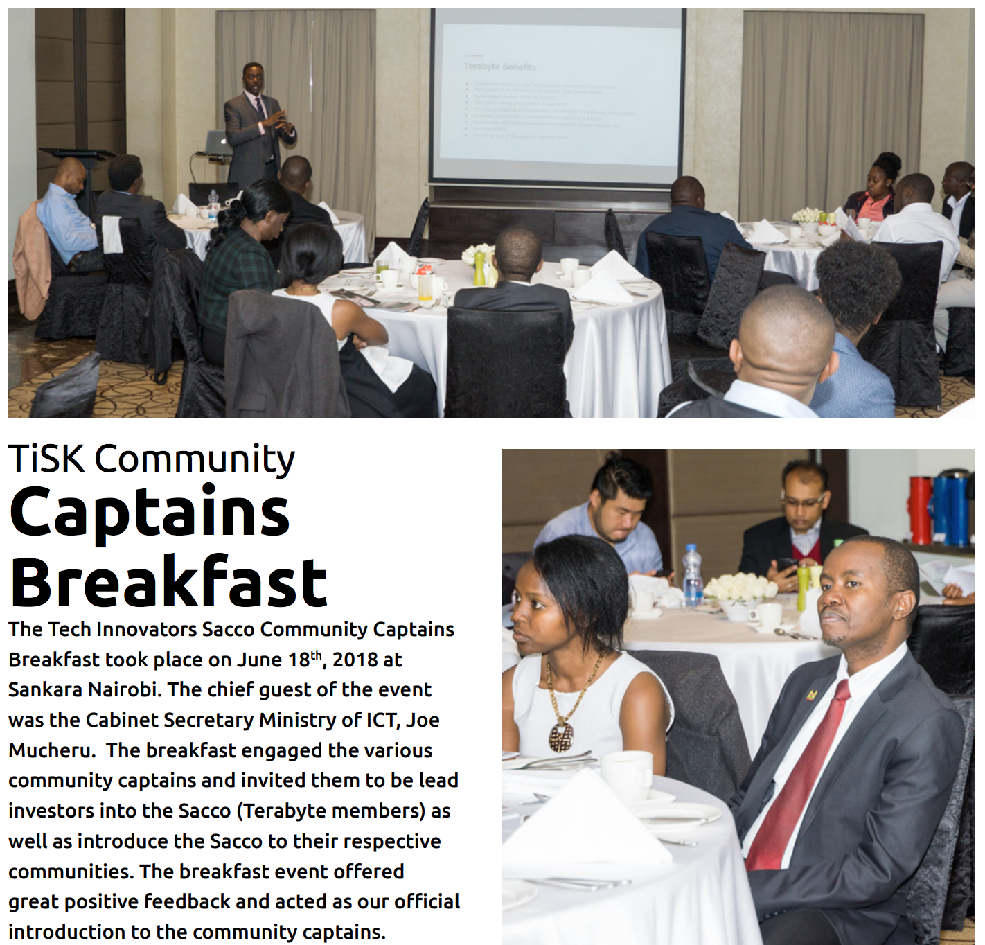
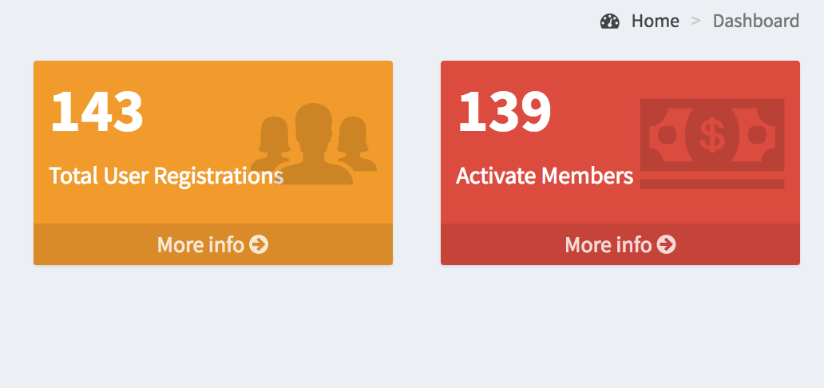
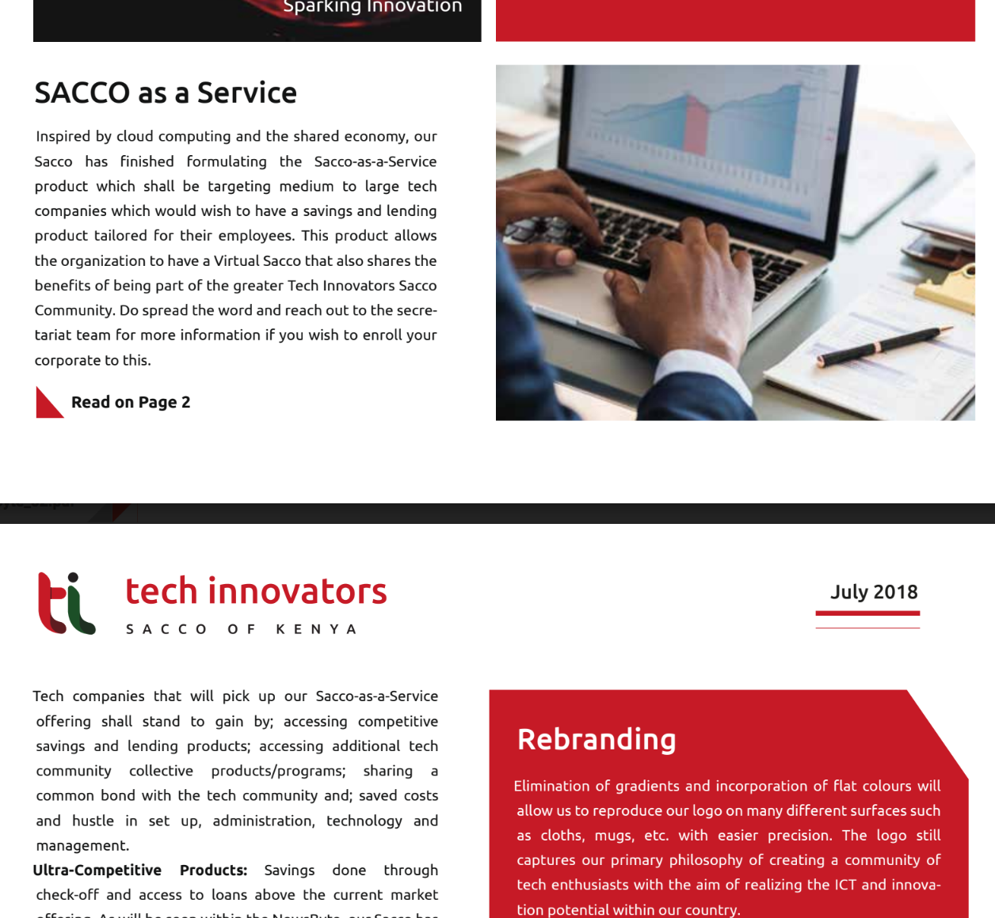
Some Statistics
TiSK Sacco founded in October 2017
Systems Go-Live June 2018
Current membership 160+
Adding about 2 members per day
Local support from top leadership

Slide 8
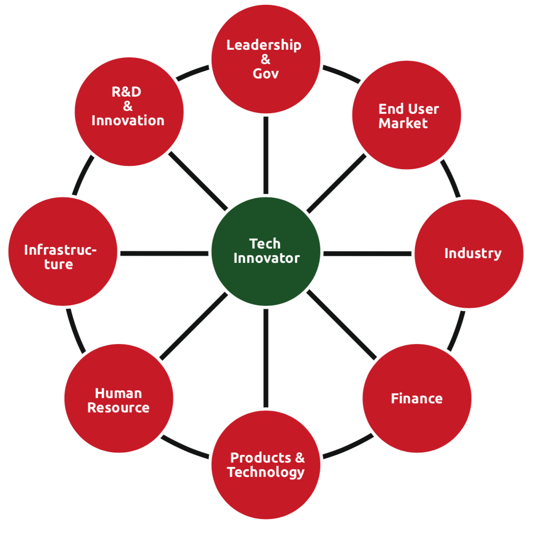
Personal & Ecosystem Enhancement Program

Slide 9
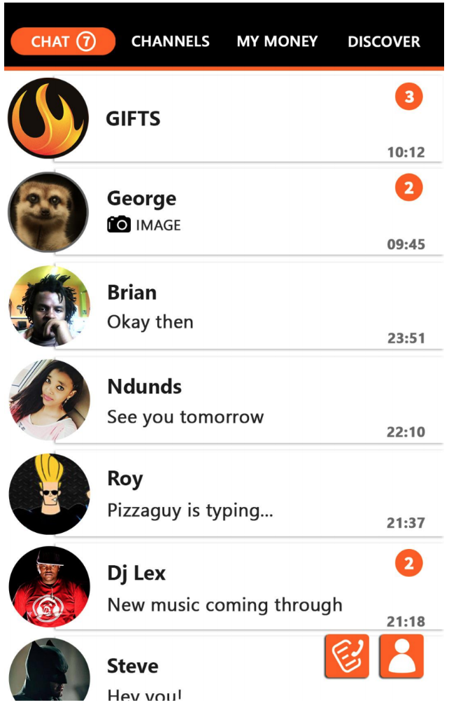
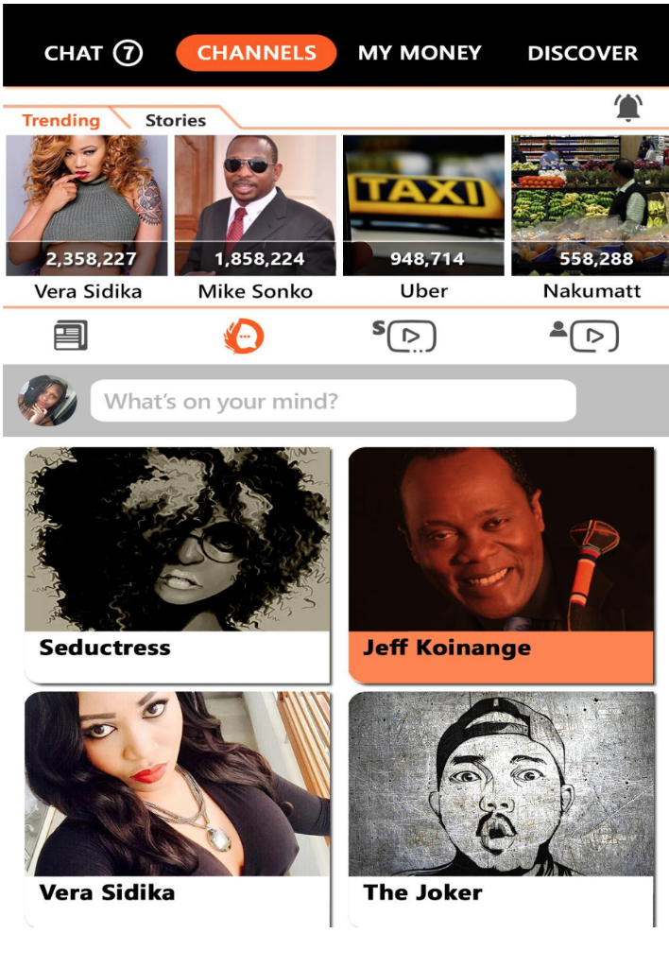
Thank You! Asante!
www.tisk.co.ke
@brianomwenga
@TiSK_Kenya

