Slide 1
Global Business Services (GBS) Sector – South Africa
March 2019

Slide 2



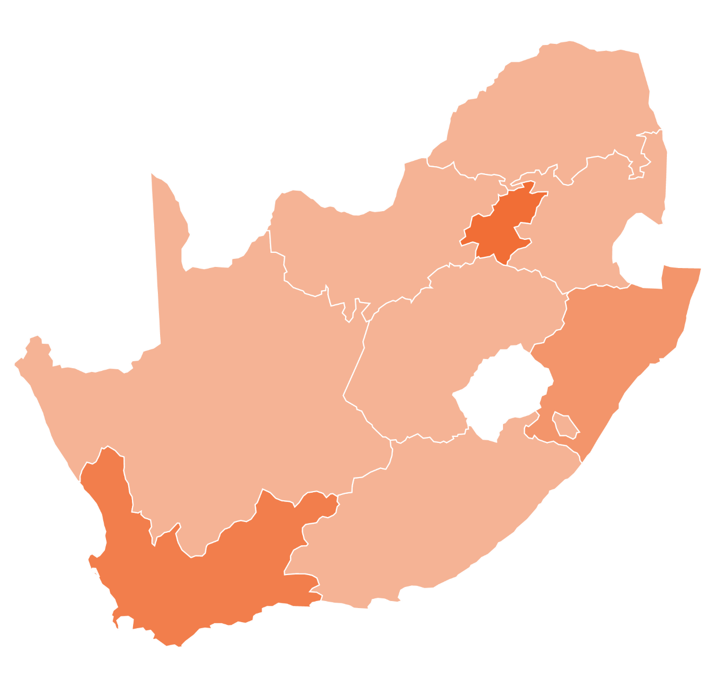



The South African GBS Market
Regional Overview of
Industry Jobs: 2017
Total Jobs: 146,304
Domestic Jobs: 138,204
Domestic Total = 190,042
Offshore Total = 38,600
Sector Total = 228,642
Offshore Jobs: 8,100
Gauteng
Other Regions
Total Jobs: 20,574
Total Jobs: 6,900
KwaZulu-
Natal
Domestic Jobs: 13,574
Domestic Jobs: 6,900
Offshore Jobs: 7,000
Offshore Jobs: 0
Total Jobs: 54,864
Western
Cape
Domestic Jobs: 31,364
Offshore Jobs: 23,500
BPESA - Stakeholder Presentation
BPESA is a proud member of

Slide 3










































































Export Market Growth
Global services¹ headcount and growth in South Africa
2014-2018(E); FTEs
  South Africa has witnessed high growth in the BPO industry over the past four years, growing by ~22% annually which is twice the global growth rate of the industry, and three times faster than India and the Philippines
  Many global and regional companies have set up or expanded their operations in South Africa; these companies represent a variety of industry verticals, such as technology and communications, financial services, legal and healthcare
21-23%
²
Key companies providing global and regional services delivery from South Africa
1 Reflects the BPO market (both business process and IT services) for global delivery in South Africa
2 Estimated figures for the year 2018
Source: BPESA, Everest Group (2018)
BPESA - Stakeholder Presentation
BPESA is a proud member of

Slide 4

Source Markets for GBS
Delivery from South Africa
South Africa serves countries spanning multiple time zones for GBS delivery
United Kingdom and Australia have leveraged South Africa for many years for customer support; this work is evolving to include customer experience management (upskilling, retention, chats and social media interaction, customer analytics, etc.)
Companies in the United States also have setups in South Africa in spite of time zone concerns – the quality of talent and lower cost
of operations in South Africa supersedes these concerns
United Kingdom
Rest of Europe
Others
63%
5%
3%
United States
Australia
4%
25%
BPESA - Stakeholder Presentation

Slide 5



Organizing our sector for execution
SUPPLY
DEMAND
Sustaining the supply of skills
BPESA
PMO
Stimulating demand
SECTOR PARTNERS
Alignment, collaboration, joint accountability
Five Year MOU between the dti, BPESA and Harambee to entrench the growth programme and goals – drafted and being reviewed internally for sign off
BPESA - Stakeholder Presentation
BPESA is a proud member of

Slide 6



BPESA’s Partnership for
Growth and Organisation
Regional presence
Regional Presence and representation in the Western Cape / Eastern Cape, KZN and Gauteng
Shared use of Invest SA Offices, which also serve as a 1 stop shop
National organisation
National membership
National structure for coordination and support
Governance with a Executive Committee and duly appointed Board of Directors
Technical Working Groups
Marketing Technical Working Group
Skills Technical Working Group
Mobilisation Technical Working Group
Alignment with Partners
Alignment with Government at a National Level through a GBS Steering Committee & a National Partnership Group (Chaired by the Minister of the dti)
  An aligned focus on the sector as a priority contribution to South Africa's economy
BPESA - Stakeholder Presentation

Slide 7
Marketing progress and plans
Done - 2018
  SA Value Proposition updated
  Joint Marketing Meetings in place
  CXO event Las Vegas
  GSA Summit & Awards
  OSX Conference London
  New York and Toronto
  Melbourne and Sydney
  Renamed sector to Global Business Services
  London (Launch of the incentives)
Planned - 2019
  Sydney – Feb (Launch of the incentives)
  Gold Coast – Feb (CCW conference)
  India – Feb (NASSCOM)
  USA – March (Launch of the incentives)
In discussion
  London – May
  Las Vegas – June (CCW)
  London – September
  Australia – October
  Investor Conference and awards (November)
Oct 2018
Dec 2018
Mar 2019
May 2019
Sept 2019
United Kingdom
United States
Jun 2018
Mar 2019
June 2019
Australia
Oct 2018
Feb 2019
Oct 2019
South Africa
Nov 2019
BPESA - Stakeholder Presentation
BPESA is a proud member of

Slide 8
Skills progress and plans
Done - 2018
  Skills forums established
  Future skills framework defined
  Skills ecosystem defined
  Skills supply chain projects underway
  Implementation of skills programmes underway impacting 480 people
Planned - 2019
  Skills strategy documentation
  Skills forums (technical working group)
  New regional programmes that will impact a further 3,000 people over the next three years
  SETA pilot programme to impact 3,000 people in 2019
  In discussion
  Future skills portal
  BBBEE recognition for non-accredited courses
  New partnerships with PBs
Future skills
Work readiness skills
Work place skills of the future
Applied Knowledge
People Skills
Legal process services
Personal Skills
Healthcare
Industry specific skills
Contact Centres
Education & Tech/Ed
Non-voice services
Banking, FS and Insurance
ICT (RPA, social media, mobile, IoT, cloud computing)
GBS specific skills
Retail
Digital skills
Telco
Data analytics, artificial intelligence and other digitally-driven services
BPESA - Stakeholder Presentation
BPESA is a proud member of

Slide 9
Five year roadmap
2018
2020
2022
Mobilise, Organise
& Engage
Move up the value
chain of services
Sustain & Grow
2019
2021
Focus, Deliver
& Transform
Compete in Industry
4.0
BPESA - Stakeholder Presentation
BPESA is a proud member of

Slide 10
Key Initiatives focused on stimulating demand
Joint Business and Government Investment Promotion Efforts
Revised Incentives
Visa policy changes and expanding on critical skills list
Engaging prospective investors abroad
Host targeted inward missions
Market intelligence, profiling and engagement
Annual investor/ industry conference in South Africa
BPESA - Stakeholder Presentation
BPESA is a proud member of

Slide 11
Key Initiatives focused on stimulating skills
Capacity building and skills development
DHET and B-BBEE Policy Changes
Ramped up work readiness training to accelerate youth employment
Investment in virtual “GBS future skills” platform and content
Upskill, reskill and future skill the workforce
Matching supply to demand
(2019 IAOP award to Harambee / the dti / BPESA for Top Impact Sourcing Country – Globally)
BPESA - Stakeholder Presentation
BPESA is a proud member of

Slide 12
Organizing our sector to report up into Presidential and technical committees
Presidential Jobs Committee
A National GBS Project Office
  Quarterly monitoring and reporting into Presidential and Technical committees
  Coordinated implementation of strategic initiatives across all regions
  Working groups to scope, plan and prioritise
Joint Technical Committee
Sector A
GBS Sector
Sector C…
National GBS PMO
Supply Side Projects
Demand Side Projects
Mobilisation
Projects
BPESA - Stakeholder Presentation
BPESA is a proud member of

Slide 13
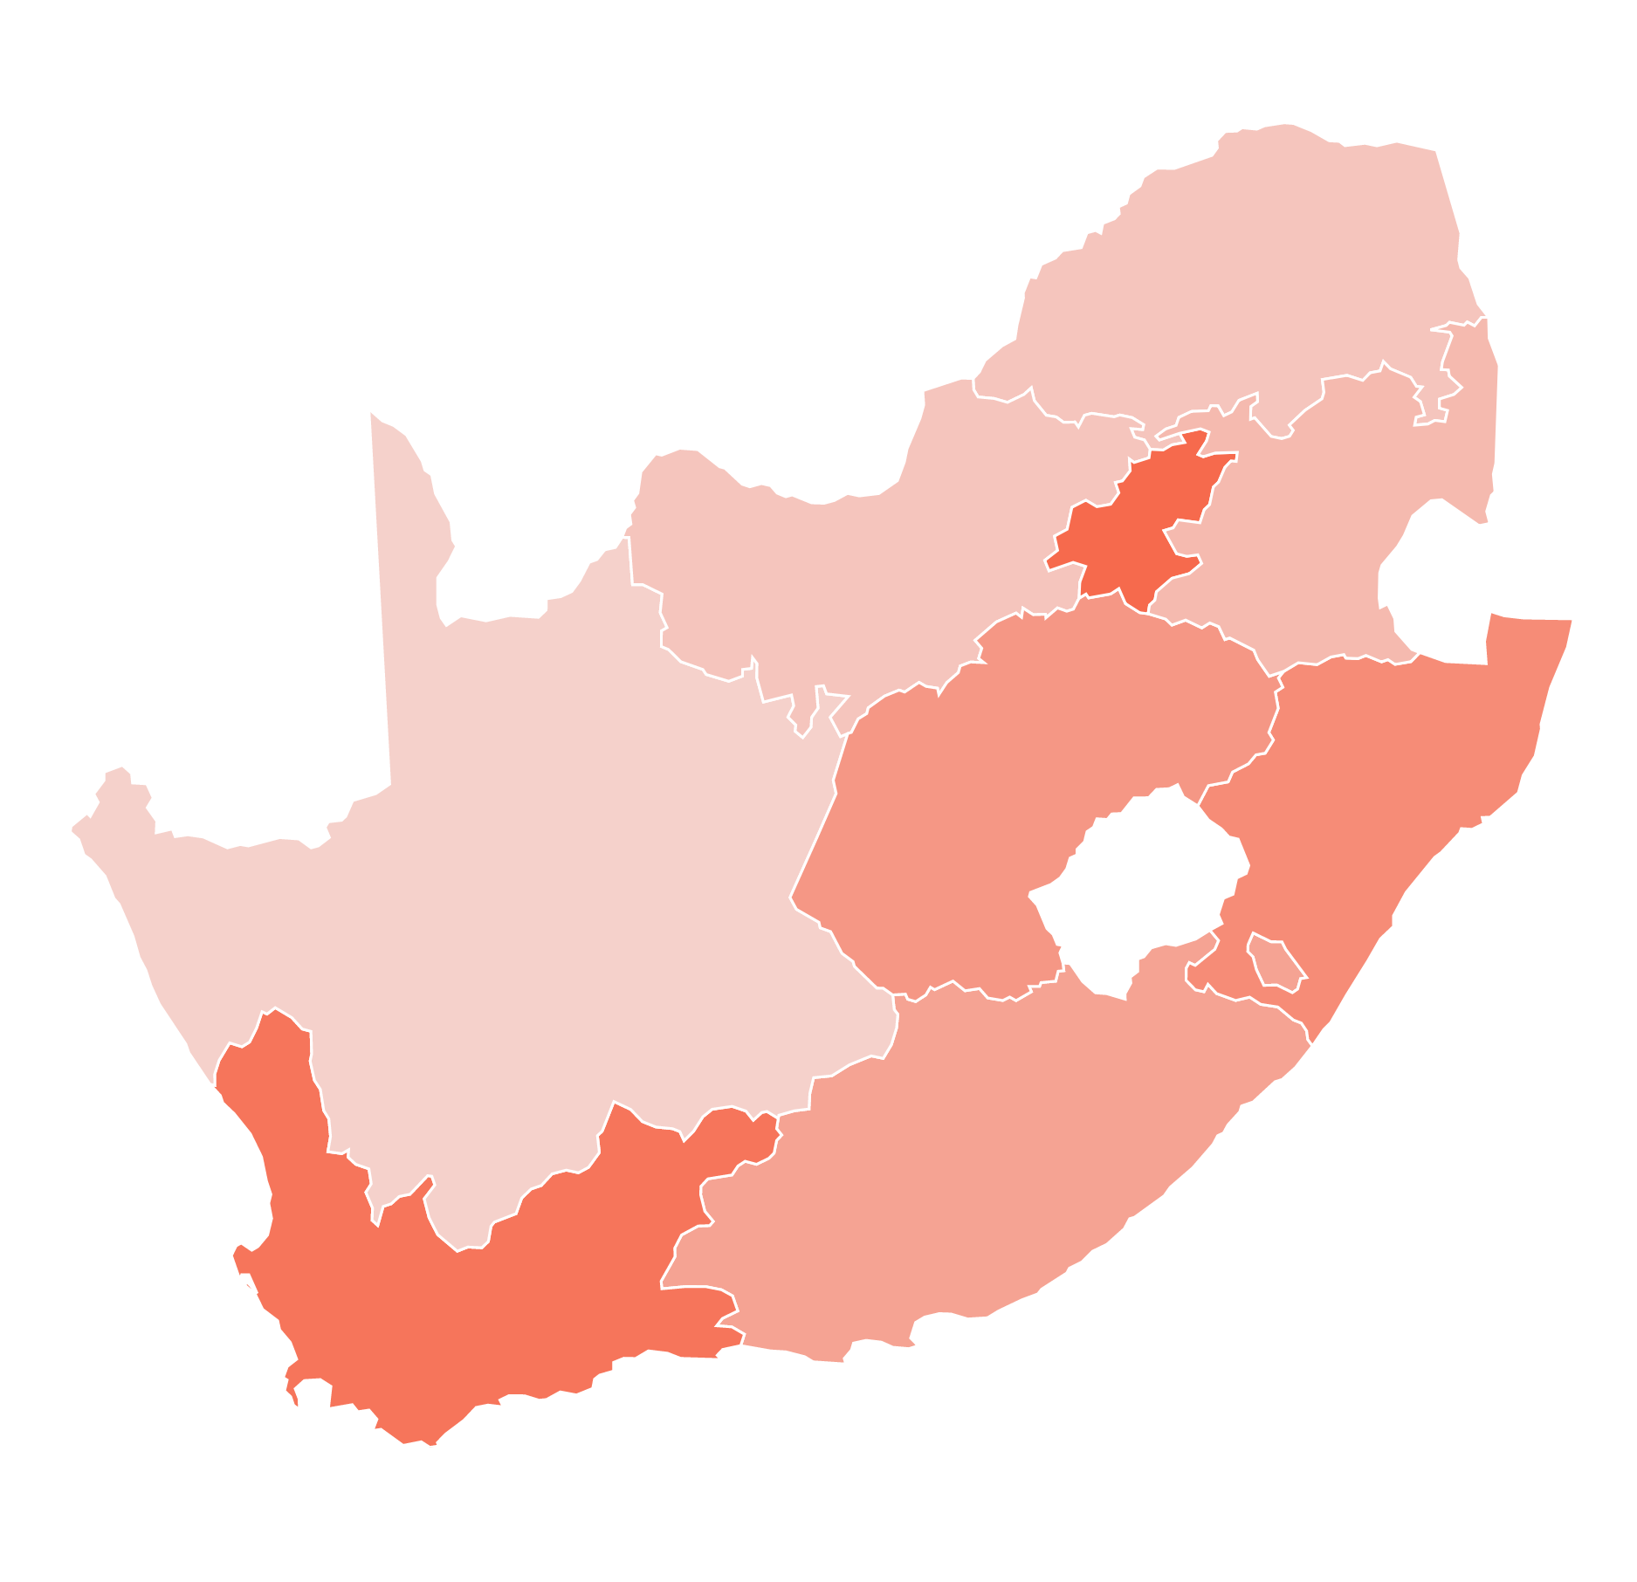











REAL VALUE…………Think South Africa
Thank you
Ke a leboga
Ngiyathokoza
Ngiyabonga
Siyabonga
Inkomu
Dankie
Enkosi
Ke a leboha
Ndo livhuwa

