Slide 1
Africa’s digital platforms:
An eight-country overview
March 2019
Notes:
The platform economy and its potentially disruptive qualities have been a source of excitement and anxiety globally. In the African context, this debate has taken place largely in the absence of information on the size and nature of platform players. Our presentation today, summarises key findings from a systemic review of virtual market places, also known as multi-sided digital platforms, that operate across eight sub-Saharan African countries. The countries were selected from Southern, East and West Africa and comprise Ghana, Kenya, Nigeria, South Africa, Rwanda, Tanzania, Uganda and Zambia.

Slide 2
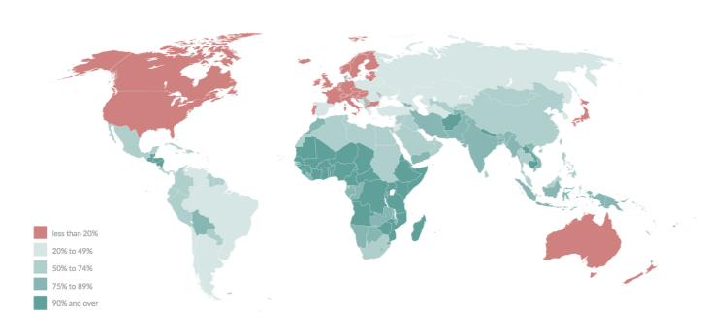
Platform participation and informality
“
A multi-sided digital platform (MSP) is a company or organisation that derives value primarily from enabling and facilitating observable, direct interactions between two or more distinct groups of users affiliated with the platform.
JP Morgan Chase (2018):
1.6% of accounts in the US
Research ICT Africa (2017):
1.3% of adult population in Africa*
”
Share of informal employment in total employment
Source: BFA, IL0 (2018)
* Aggregated across Ghana, Kenya, Nigeria, Rwanda, South Africa, Tanzania and Uganda
Notes:
Digital platforms provide new income generating opportunities to millions of participants.
In a survey undertaken by Research ICT Africa, on average 1.3% of adults in our focus countries earn income through participating in the platform economy.
The average rate of participation in the platform economies of our eight African focus countries compares well with more digitally advanced and developed countries, such as the USA where the JPMorgan Chase Institute estimated that 1.6% of their account holders earned income from the platform economy in 2018.
Africa’s digital platforms have a valuable opportunity to transform the economies of Africa, where the informal sector dominates. This is a heat map of the share of informal employment as a proportion of total employment, and we see for a large proportion of African countries informal employment is 75% or higher.
Africa’s informal sector dominant
Low levels of formal employment
Large number of micro-enterprises with low production capacity
Production standards for goods and services not enforceable
Underdeveloped supply-chains
Low tax base

Slide 3
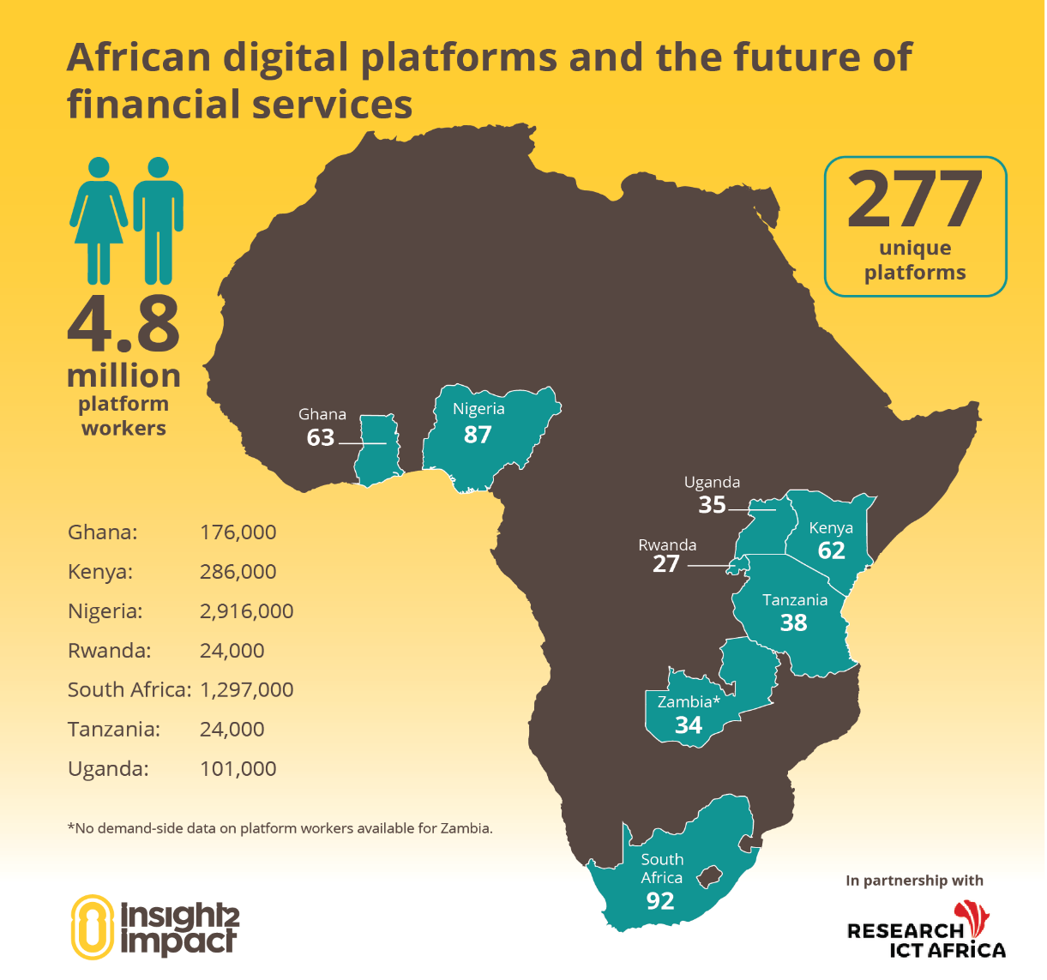
The landscape of Africa’s digital platforms
Significant numbers of homegrown platforms across eight focus countries
19
14
Origin of platforms
22
222
Source: i2i (forthcoming)
Notes:
We estimated that 4.8 million workers derive an income from platform-mediated work in 2017, based on survey data from Research ICT Africa for seven of the eight countries we studied. The largest number of workers are found in Nigeria, South Africa and Kenya. We also identified these economic giants as being home to the largest number of multi-sided digital platforms across the 8 countries we reviewed.
Surprisingly, we found that a large proportion – more than 80% - of Africa's digital platforms are homegrown, and these platforms understand deeply how the local context shapes platform participation and financial inclusion in Africa. Just over 13% of the identified platforms are also found to operate in multiple African geographies.
Platforms from origin ‘other’:
Australia and South-East Asia, mostly.
(Examples: Mealsharing – Cambodia, Petbacker – Malaysia, 99designs – Australia)
Interestingly, we didn’t find any platforms from China.
Platforms operational in multiple countries: 37
From Africa: 14 (mostly in 2 or 3 countries) (mostly e-hailing and online shopping) (examples: Little, Zip Taxi, Jumia)
From USA: 12 (mostly 3 or more, up to 8) (mostly freelancing and travel-related) (examples: Airbnb, Uber, Paydesk, Upwork – the usual suspects)
From Europe: 9 (mostly 6 or more) (diverse sub-classifications) (examples: Booking.com, Taxify, Parcel Monkey)
Research ICT Africa’s survey frames microwork activity as follows, “Some people find paid jobs or tasks by connecting directly with
people who want to hire them using a particular type of website or mobile app. These sites require workers to create a user profile in
order to find and accept assignments, and they also coordinate payment once the work is complete.”
About the RIA Survey:
Nationally representative
Conducted in 2017
Conducted in Ghana, Kenya, Nigeria, Rwanda, South Africa, Tanzania, Uganda (NOT Zambia)
Between 1171 and 1815 respondents per country
Sampling based on population size (World Bank) and urban-rural split. Enumerator areas determined based on urban-rural, and households were randomly selected from within those enumerator areas.
Final results are weighted back up to represent the total population, based on that same data on population size and urban-rural split.

Slide 4
The rise of Africa’s digital platforms
Sources: i2i Africa’s Digital Platforms database (2018), World Bank Findex (2017), World Bank World Development Indicators
Notes:
Multi-sided digital platforms are virtual marketplaces that connect providers of goods and services with consumers. Platforms that connect buyers and sellers, such as village market squares, are as old as human economic interactions. The digital nature of emerging platforms allows for the matching of new services (e.g. e-hailing) with fewer geographic constraints (e.g. online shopping and freelance). Advances in online payment instruments also allow for the payment of goods and services on these digital platforms.
Since 2005, the number of new platforms being launched grew rapidly to 277 (of which we could obtain the exact launch year for 268). In 2016, a record of 63 platforms were launched, originating predominantly from our focus countries, to match provider and consumers for the first time.
Sub-Saharan Africa (SSA) has experienced rapid growth in internet penetration and related tech investment over this time, and we think these factors have supported the development of the platform economy. Moreover, improved levels of financial inclusion has enabled more individuals to participate in the platform economy, as financial services are often a prerequisite to transact and receive income on platforms.

Slide 5
Online shopping and freelance platforms most common
Online shopping the most prevalent type of digital platform in Africa, followed closely by freelance platforms
91
75
53
37
Number of active digital platforms per type
27
26
Note: The e-hailing platform Taxify was rebranded to Bolt in March 2019
Notes:
Platforms operate across a diverse set of ecommerce sectors, including online shopping (goods and restaurants), freelancing, e-hailing, logistics/courier, rental or asset-sharing activities and other types such as ticketing platforms. By number of platforms identified across 8 African countries, we find that online shopping the most prevalent type of digital platform in Africa, followed closely by freelance.
Online shopping platforms are virtual marketplaces that enable consumers to directly access and purchase products or food items displayed by vendors over the internet.
Freelance platforms connect companies to gig workers who perform online and/or offline tasks.
E-Hailing platforms connect passengers and local drivers of cars, taxis or other forms of transportation using virtual devices such as a mobile device or computer.

Slide 6
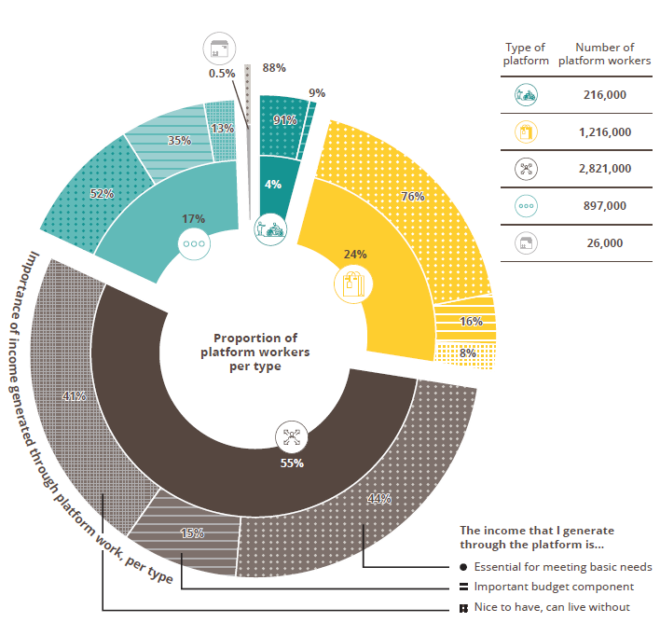
Platform-generated income reported as essential for meeting basic needs
Source: RiA/I2i infographic (2018)
Notes:
On average, just over 50% of platform participants (also known as microworkers) reported this source of income as essential for meeting their basic needs.
We find that self-reported economic reliance on platform-generated income is greatest in the case of microworkers who are matched by online shopping and e-hailing platforms, where 91% and 76% of platform workers, respectively, cited platform income as essential for meeting their basic needs.
In the case of the freelance sector where the majority of microworkers are active, self-reported reliance on platform income is more mixed: 44% cited platform income as essential for meeting basic needs, while 42% said that platform income is nice to have, but they can live without it.

Slide 7
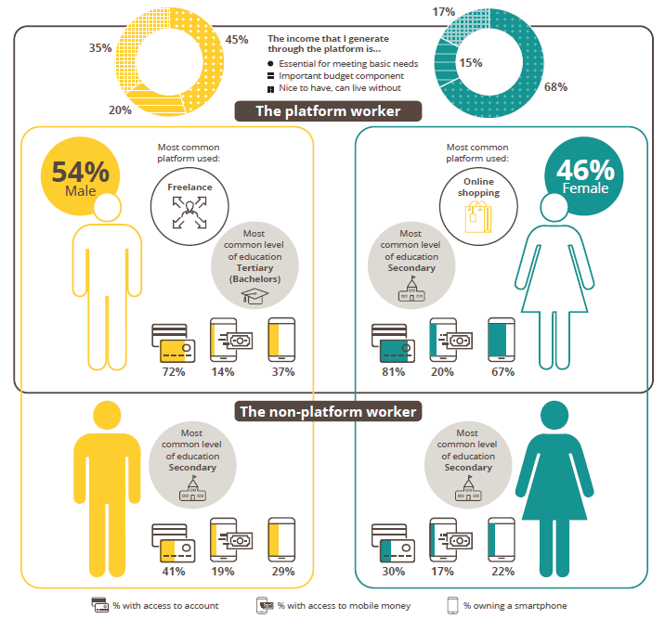
Platform workers evenly split across gender but with significantly different characteristics
Source: RiA/I2i infographic (2018)
Notes:
We find that platform workers are roughly evenly split across gender, but with significantly different characteristics.
Female platform workers report a stronger economic dependence on income generated through the platform. Moreover, male workers are found to be more active in the online/offline work space, while female platform participants more commonly provide goods in the online shopping space and have lower levels of educational attainment.
When we compare platform workers to non-platform workers we find that those that have successfully entered the platform market tend to have higher levels of financial inclusion and smartphone ownership. This illustrates how important financial services and internet infrastructure is for entry into the platform economy.

Slide 8
Opportunities to close financial barriers to platform participation
Source: i2i (forthcoming), World Bank Findex (2018)
Notes:
Financial services, especially payment products, are essential to transacting in the platform economy. For providers of goods and services, including gig workers, access to a bank account and/or mobile account is a requirement to registering on a digital platform to be matched and an earn an income.
We find that there are significant gaps between the payment methods accepted by platforms, and the payment methods the population has access to. For instance, 75% of the digital platforms we identified in our study allow providers of goods and services to receive an income through bank transfer, but only 41% of the population has access to a formal bank account. Due to the barriers associated with access to financial services, a number of platforms have introduced cash as means of transacting. We think that innovative payment mechanisms such as digital wallets and mobile payments offer an opportunity to connect more platform workers to income-generating opportunities. In East African countries, mobile payments are a prevalent payment product being accepted by digital platforms.
PayPal also a digital wallet, has recently partnered with MPesa

Slide 9
Partnerships between digital platforms and FSPs bringing financial services to platform participants
Asia
Sub-Saharan Africa (SSA)
Source: i2i (forthcoming)
Notes:
Of the 277 digital platforms identified in our study, 15% offered one or more insurance, digital wallet, savings or credit product. Partnerships between digital platforms and financial service providers (including Fintech) have enabled broader distribution of high-value financial services to platform participants and workers.
Examples:
Dropping/People’s Pension Trust: Partnered to offer an embedded pension product to e-hailing drivers. In the first three months of platform participation, Dropping services the pension fund contribution on behalf of drivers who achieve an average of 20 completed trips per week.
Hometogo/Allianz: Partnered to offer optional group insurance for travellers being matched to property rentals on the platform.
Simply/SweepSouth: Partnered to offer life and disability insurance to the household cleaners who participate on the platform in South Africa. The insurance is offered as an embedded product with no additional cost to its platform participants.
Uber/Jumo: Partnered to provide drivers with cost-effective credit to finance the purchase of vehicles. Uber piloted the credit product in Kenya and intends to expand distribution efforts to other SSA markets in 2019.

Slide 10
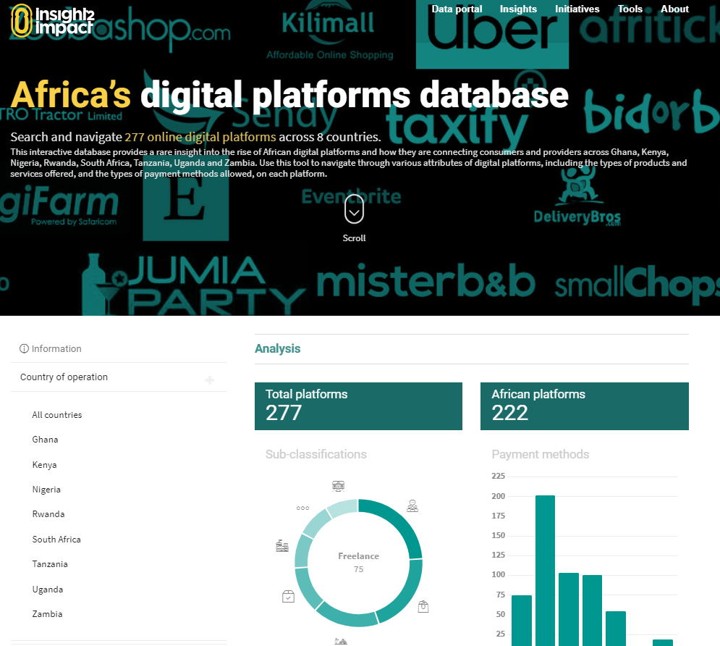
More content: Africa’s digital platforms
Focus note
out this week
Join the conversation:
#AfricanDigitalPlatforms

Slide 11
How to find us
Get involved. Contact us.
Chernay Johnson (Engagement Manager)
chernay@i2ifacility.org
@i2ifacility
/insight2impact
/insight2impact
/i2ifacility
i2ifacility.org
Established by
Sponsored by

