Slide 1
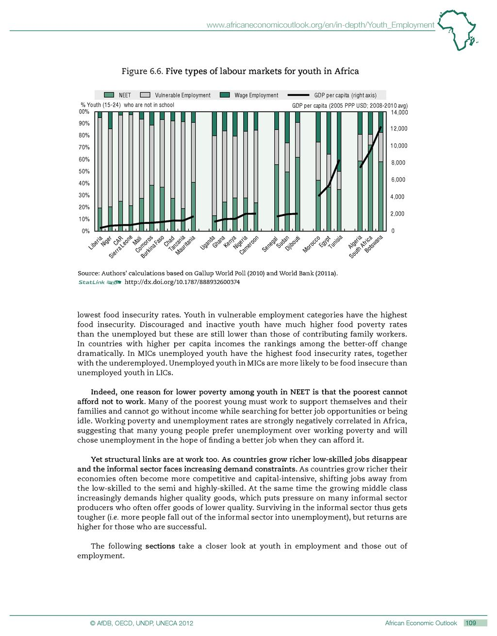
ADB, 2012
ADB, 2012
Notes:
Differences between low, middle and upper middle income countries – no one size fits all approach
LICs have large proportion of youth employed in vulnerable employment – 80% are in the informal sector compared to UMICs
As GDP per capita increases, informal employment and work in the agricultural sectors decrease
But there is a rising NEET group as countries grow
Source: Graham et al 2018, Elder & Kone 2014, ADB 2012

Slide 2
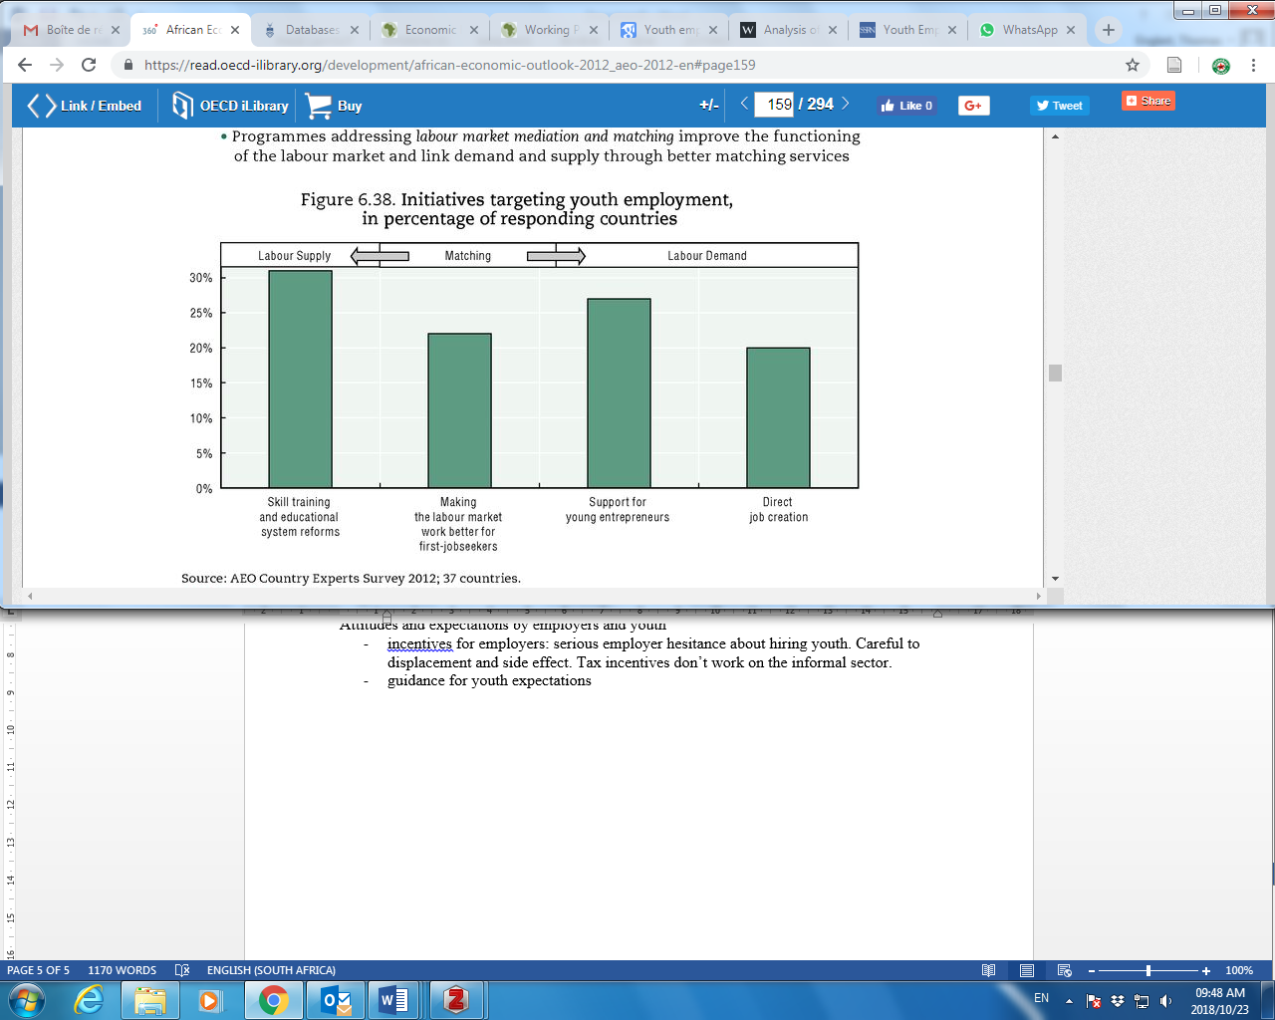
ADB, 2012
Notes:
Skills training and education system reforms are the most common initiatives followed by entrepreneurship. Matching and job creation lag behind

