Slide 1
Opportunities and Constraints in Gig Economy in Africa
Dr. Mohammad Amir Anwar
Oxford Internet Institute, University of Oxford
The School of Tourism and Hospitality, University of Johannesburg
Digital | Economy | Africa Conference
March 27-28, 2019
Notes:
Hi everyone and thanks Emmanouil, Joanna, and Doug for your interesting presentations.
I am Sanna Ojanperä, and work as a researcher here with the Oxford Internet Institute
Today I will present work carried out together with a few colleagues – including Mark, Stefano, Ralph, and Matt.

Slide 2
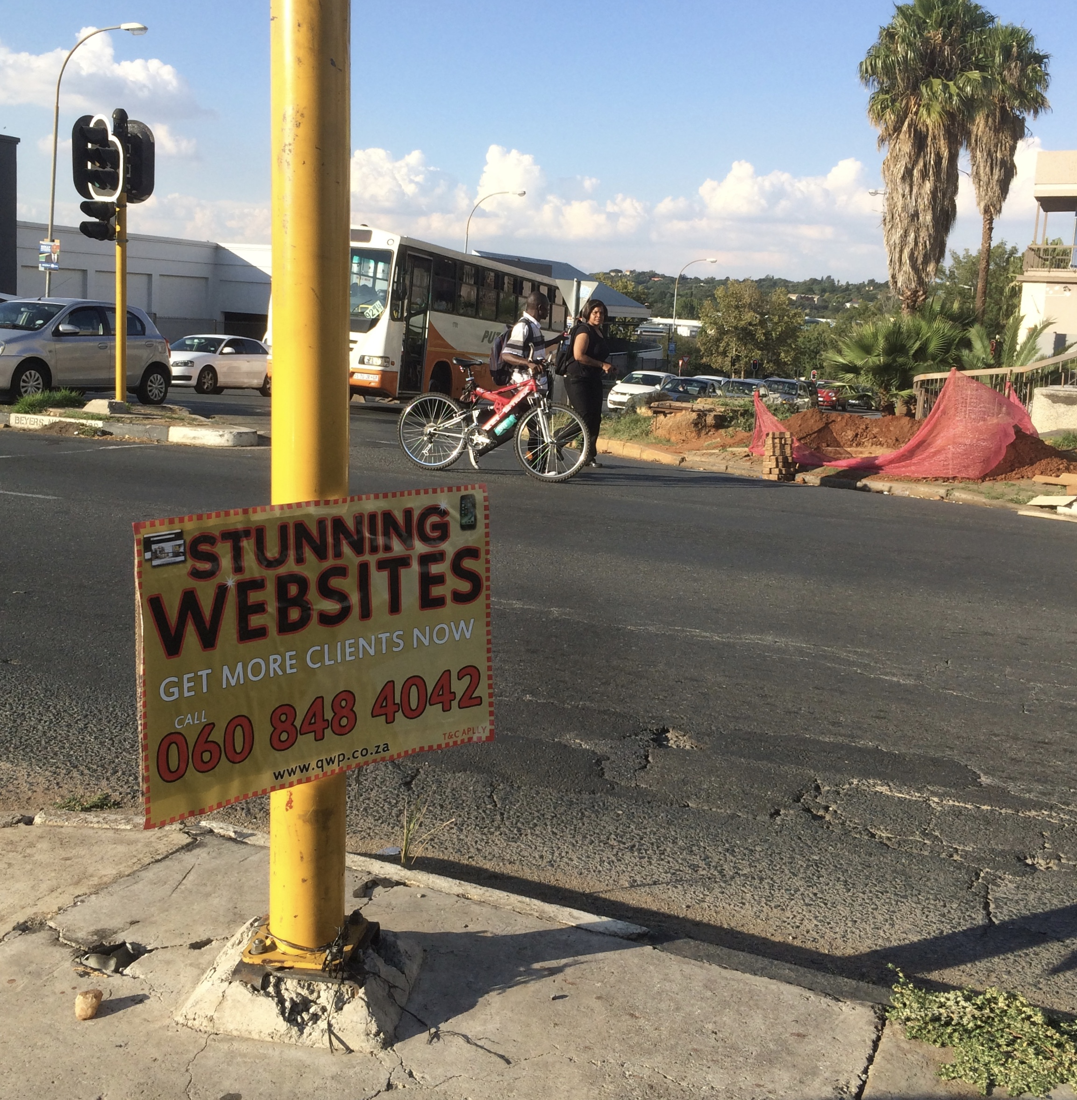
High unemployment

Slide 3
Growth of platform work

Slide 4
Market Share

Slide 5
Workers distribution within regions

Slide 6
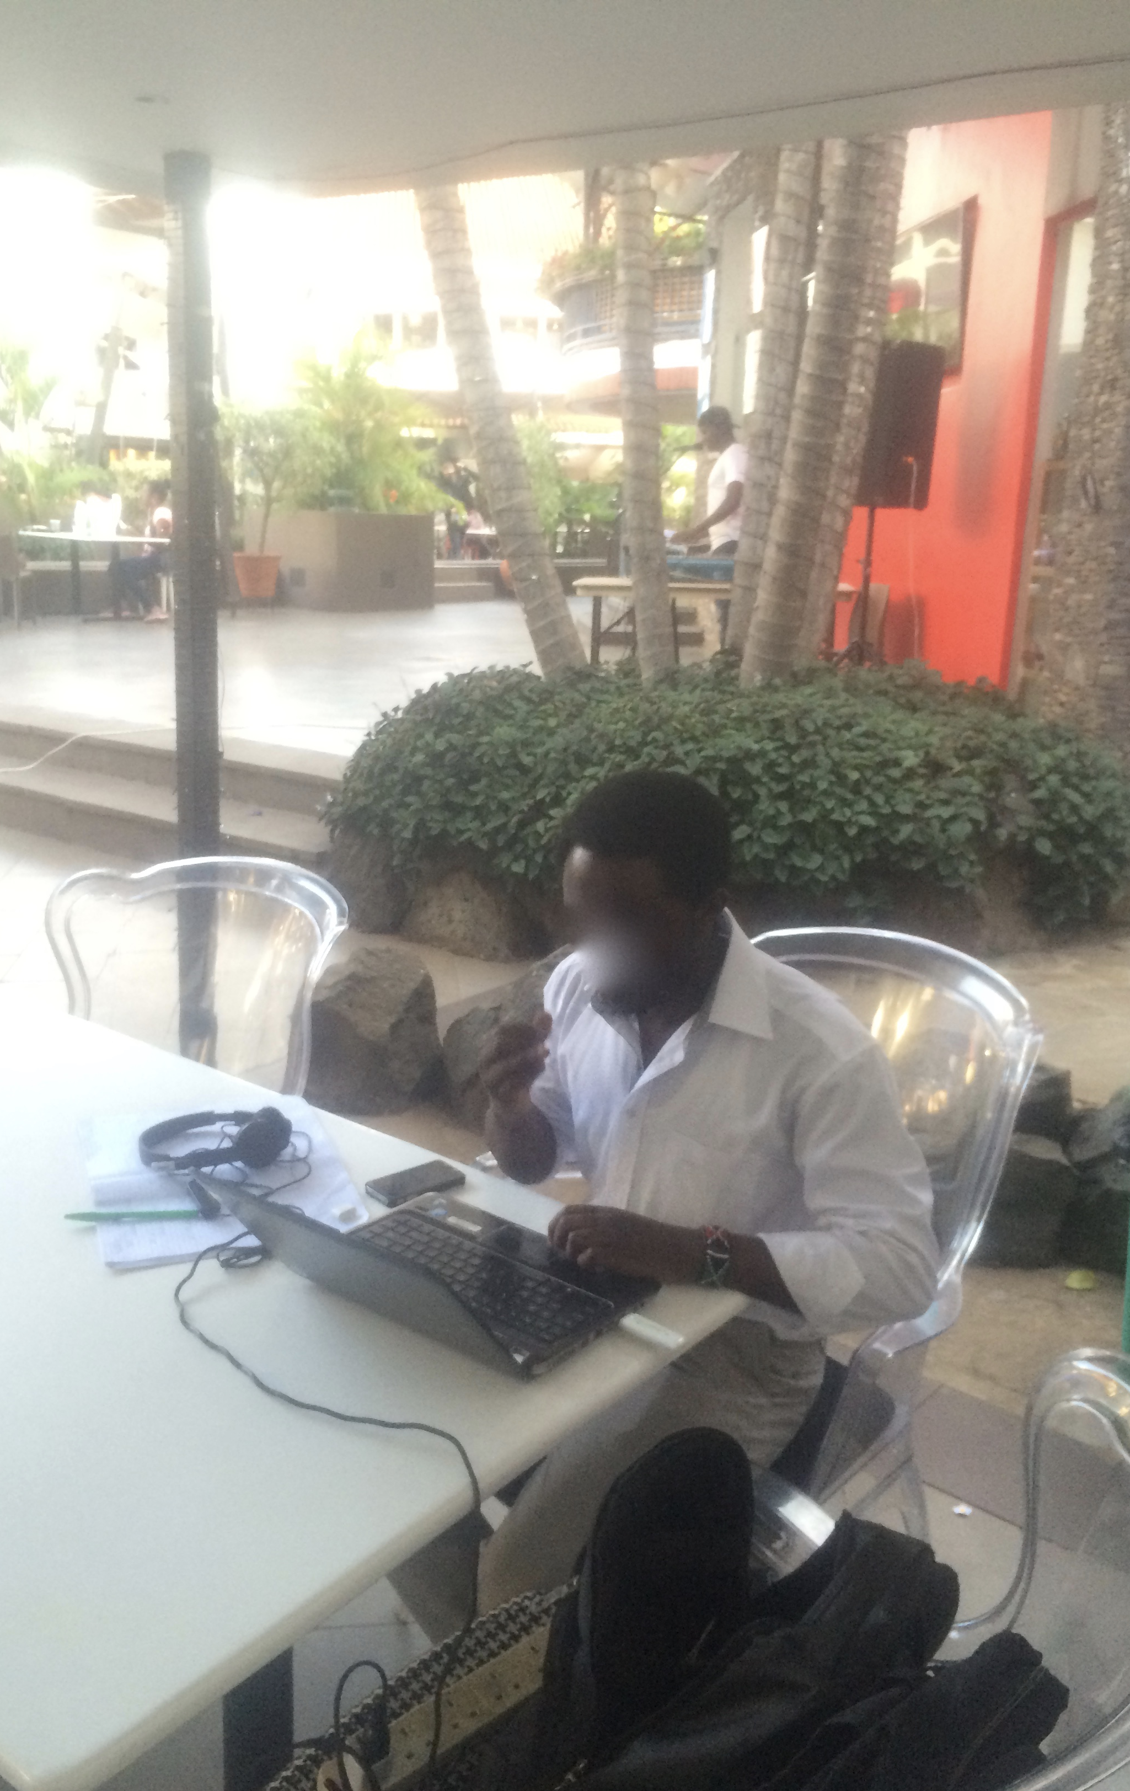
Transcriber
Video-editor
Writer
Web Research

Slide 7
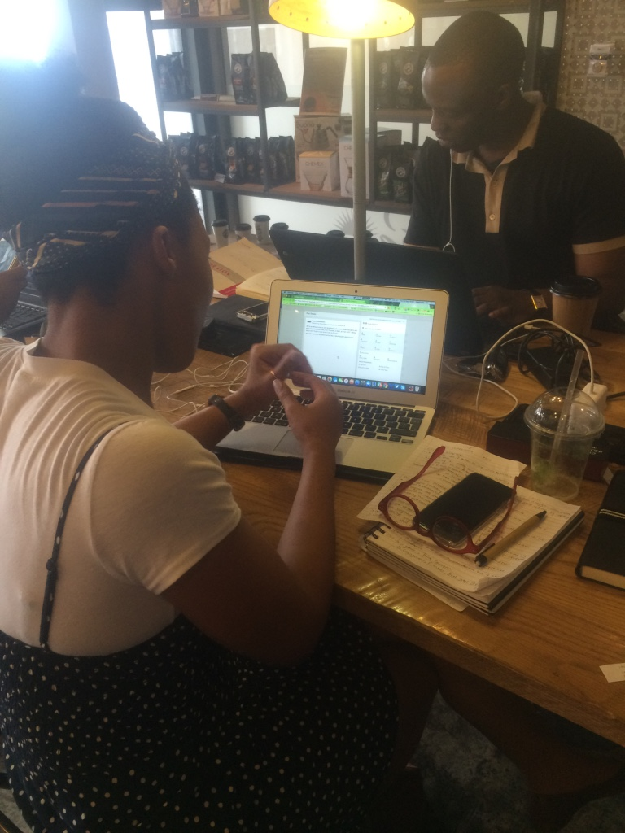
Digital Marketing
Manager
Writer
Data Entry Worker

Slide 8

Social Media
Manager

Slide 9
Freedom and flexibility: workers’ perspective
“I’m making about twice as much as I was when I was working fulltime.”
  A Ghanian worker
“I was attracted to the whole concept of working online firstly for freedom…I’m a kind of person that loves that freedom and having your own opportunity to set your own schedule and do your own thing.”
A Nigerian worker
“Positives, they are many. You can work anytime. You can work anywhere as long as there is a working internet connection.”
  A Kenyan worker

Slide 10
Contradictions
“Freelancing is the best thing that has happened to me.”
“Yes, I’ve done that so many times, coffee and Coca-Cola, one full bottle of Coke, or maybe two…there’s been times when I have been indoors on my bed and…I only have water in my fridge because I’m broke, flat and I can’t call anybody to say hey, lend me 100 Ghana Cedis…I’d rather stay hungry for days...”
A Ghanian worker

Slide 11
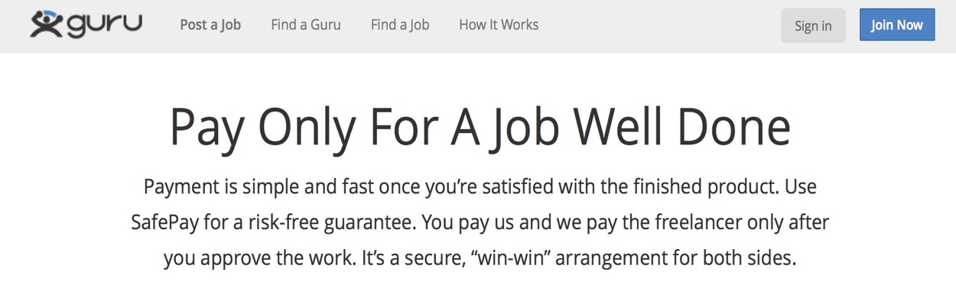
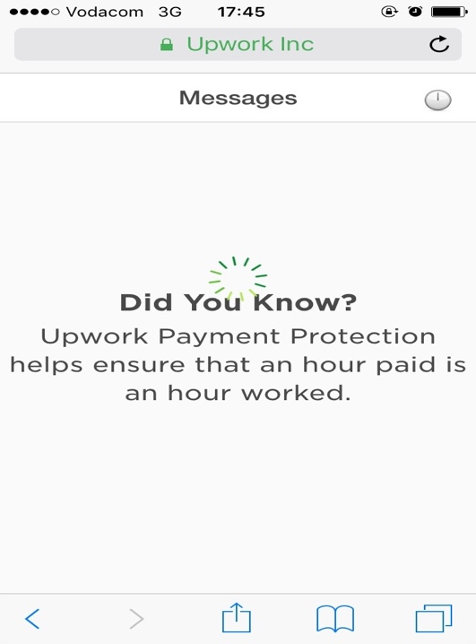
Lack of bargaining Power

Slide 12
Over supply of labour on Upwork (on March 27, 2019)
Country | Potential Workforceª | Workers with $1 earned | No earnings | Over-supply Percentage (%)
Global | 2,151,611 | 189,342 | 1,961,819 | 91.1
United States | 698,065 | 39,120 | 557,872 | 79.9
India | 262,630 | 31,420 | 231,210 | 88
Philippines | 173,970 | 23,113 | 150,857 | 86.7
African Continent | 112,426 | 6,569 | 105,857 | 94
Egypt | 40,346 | 1,932 | 38,414 | 95.2
Kenya | 20,207 | 1,517 | 18,690 | 92.4
South Africa | 14,402 | 922 | 13,480 | 93.5
Nigeria | 8,822 | 708 | 8,114 | 91.9
Ghana | 1,735 | 91 | 1,644 | 94.7
Uganda | 1,271 | 57 | 1,214 | 95.5
Tunisia | 6,269 | 278 | 5,991 | 95.5
Morocco | 8,686 | 372 | 8,314 | 95.7
Other African countries (17)* | 1,848 | 151 | 1,697 | 91.8
* Angola, Benin, Burkina Faso, Burundi, Chad, Congo, Democratic Republic of the Congo, Ethiopia, Guinea, Mauritania, Mali, Malawi, Niger, Rwanda, Senegal, Sierra Leone, and Somalia

Slide 13
Precarity and vulnerability
  Lack of choices.
  Insecurities (job and income insecurities).
  Withholding of wages.
  High work intensity.
  Social isolation.

Slide 14
Exception: agency of workers
“I received phone calls from clients and meet supply orders, I would phone clients to see if they have received payments, I balanced his [employer’s] books. I basically did almost everything…So, all these things I held in my hand…Every time he’d [employer] let me go, things would get crazy and within a week he would hire me again.”
A Kenyan worker

Slide 15
What is to be done?
We too have worked with a concept that puts capitalist development first, and workers second. This is a mistake. And now we have to turn the problem on its head, reverse the polarity, and start again from the beginning: and the beginning is the class struggle of the working class.
Mario Tronti
Collective Action?

