Slide 1

COMMUNICATING KENYAN ENTREPRENEURSHIP
Geonet Digital Economy Africa Conference
University of Johannesburg, 2 March 2019
Dr Eleanor Marchant
Postdoctoral Research Fellow
Centre for Socio-Legal Studies, University of Oxford
@ermarchant
eleanor.marchant@csls.ox.ac.uk

Slide 2

Notes:
How many people know the iHub?
I’m going to use it to illustrate
Why I think a communication lens is essential to understand African tech entrepreneurship AND
Some lessons from their experiences for communicating African entrepreneurship

Slide 3


Notes:
Situated in Bishop Magua
In subburb

Slide 4
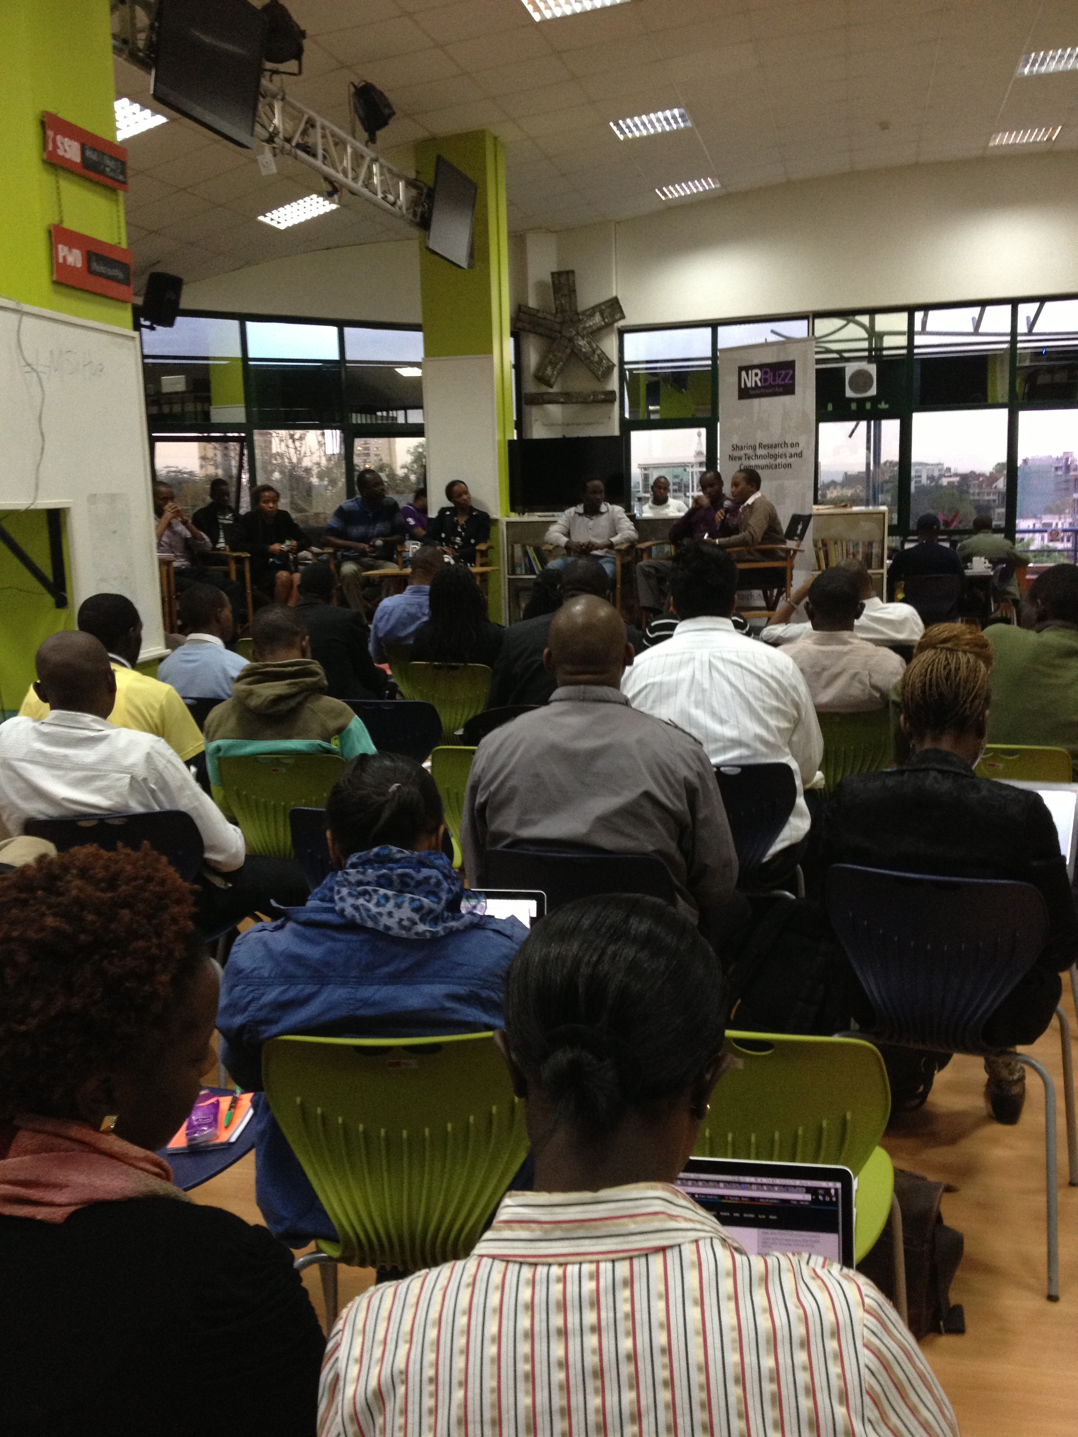
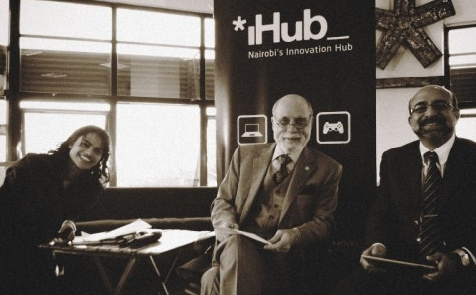
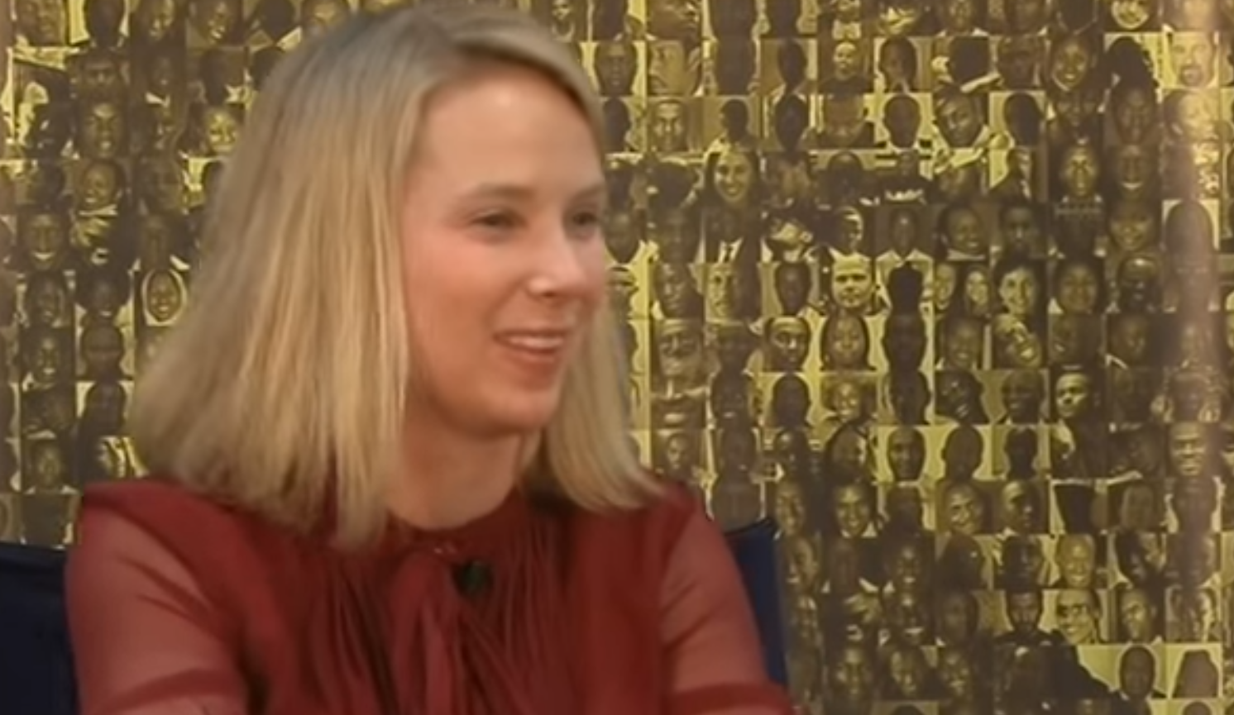
Notes:
And held numerous events

Slide 5
Methodology
Ethnography
3 months of preliminary research in 2013 & 2014
12 months of participant observation in 2016
82 interviews
1 focus group discussion
34 events attended
534 pages of fieldnotes
9 site visits to other hubs
“deep hanging out”

Slide 6
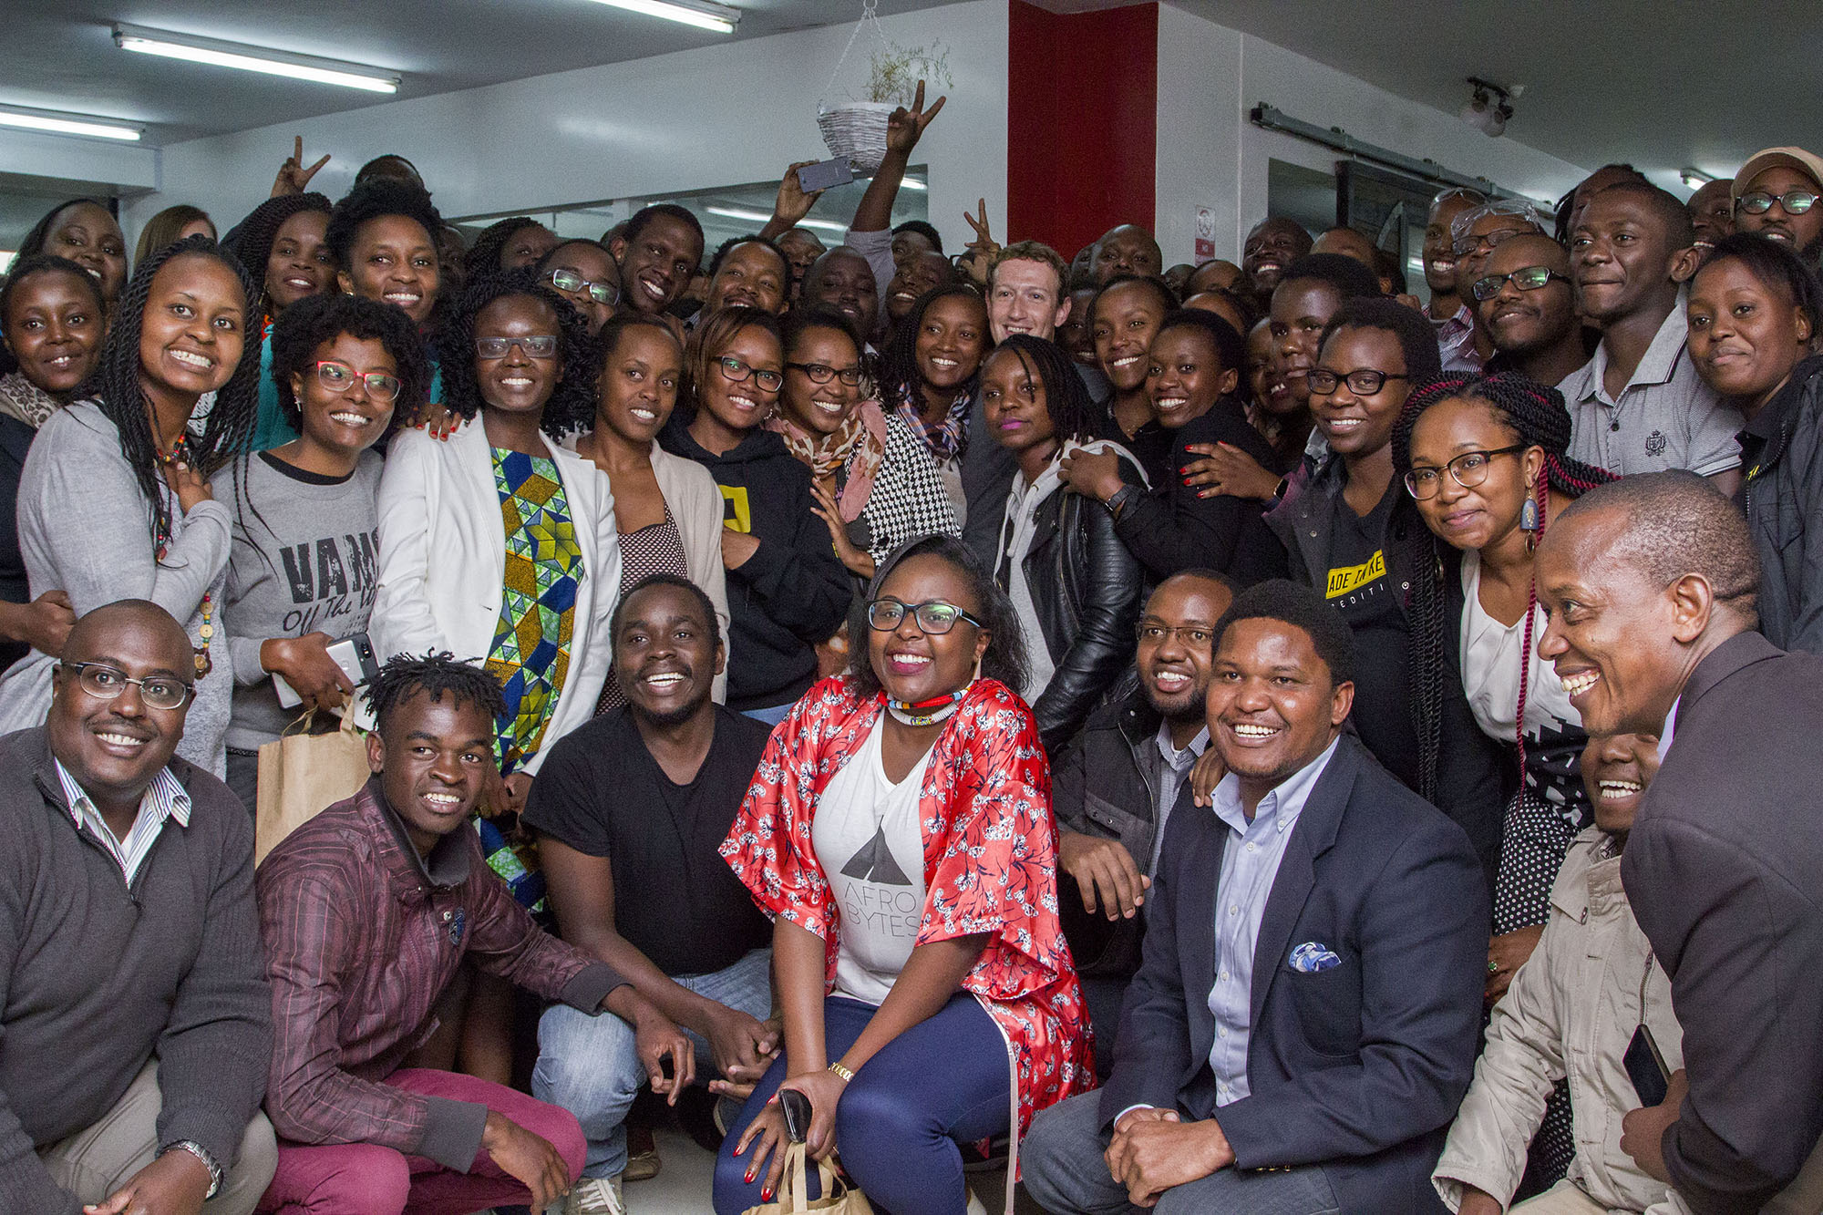
iHub official photo (Sept 2016)

Slide 7
A communications lens
Stories and narratives in a community of practice
Notes:
NARRATIVES AND STORIES SHAPE PRACTICES AND VICE VERSA
Narratives shaping practice – mutual construction

Slide 8
Stories & Narratives
Stories: True and untrue tales told by individuals or organizations that come with a story arc, a hero, and sometimes a lesson
Narratives: Larger culturally dominant tales that are formed through the telling and retelling of individual stories
Notes:
Stories build narratives
Narratives interact with other narratives
They are shaped by practice and they in turn shape practice

Slide 9
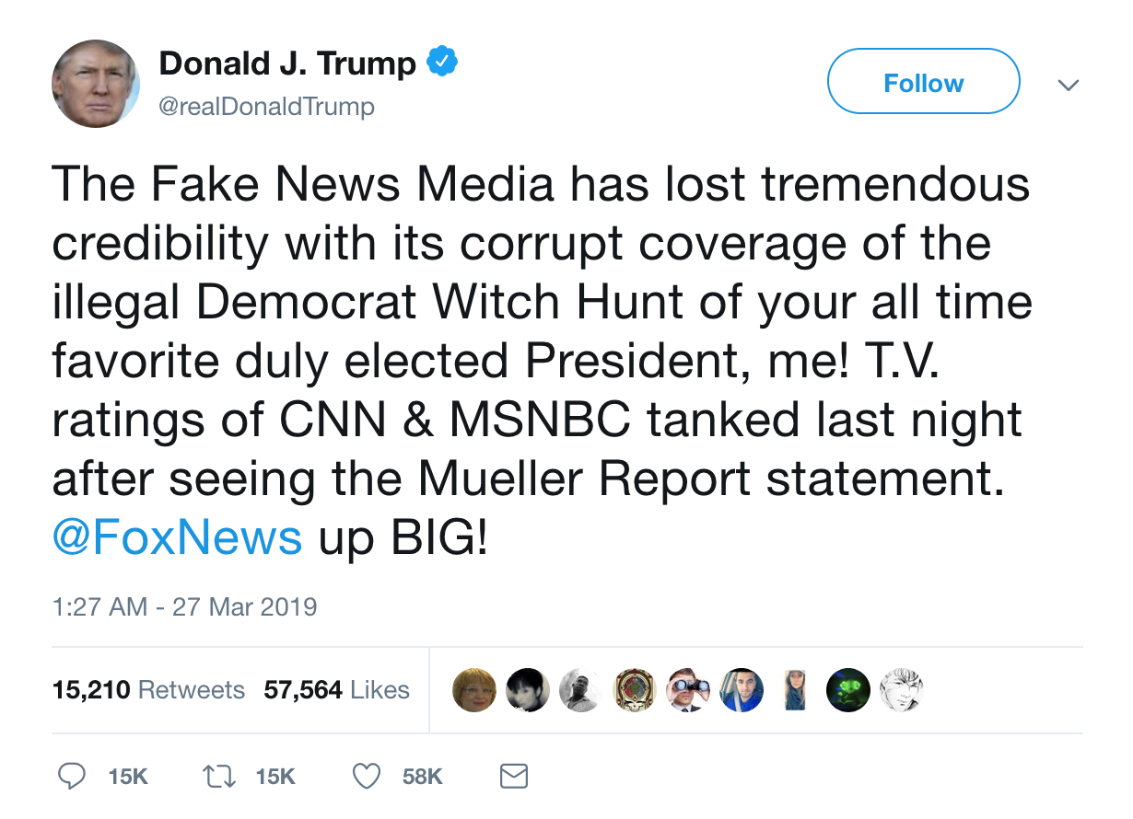
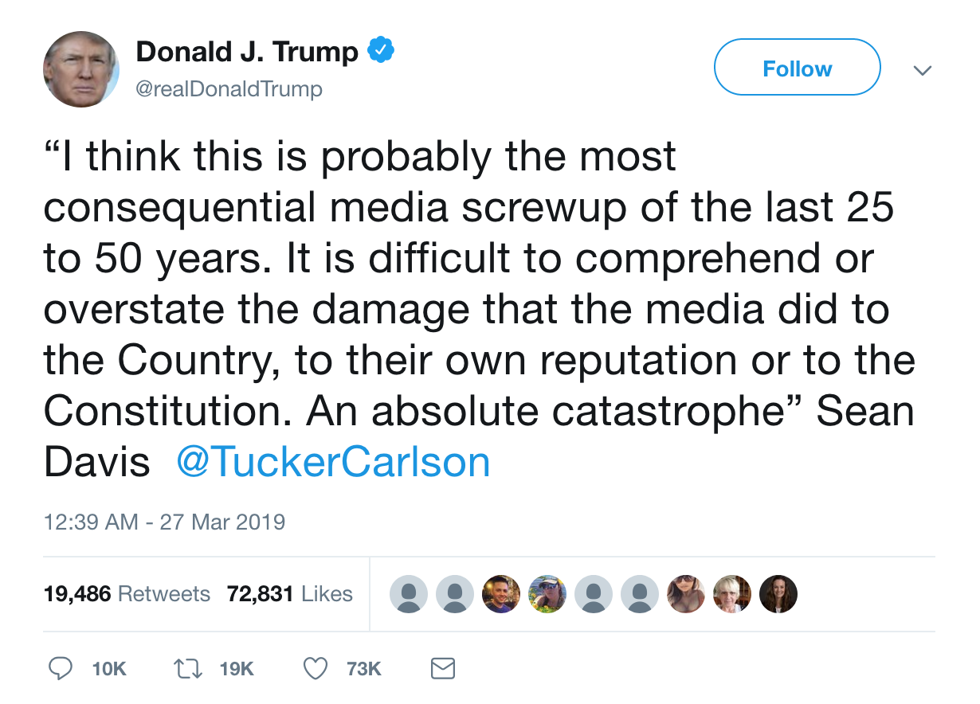
Notes:
Trump invidual stories building up a larger narrative about a corrupt and fake news

Slide 10
Fitting into existing narratives
Lesson 1: Entrepreneurial storytelling is easier when you can fit into existing narratives
Notes:
As an entrepreneur isn’t just about the particular story you tell, but also about how those stories fit into larger narratives. It is much easier to fit into existing narratives than to try to create new ones
-> Why the iHub was successful at creating a narrative about a growing tech movement in Kenya

Slide 11
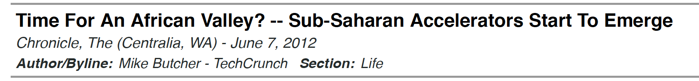
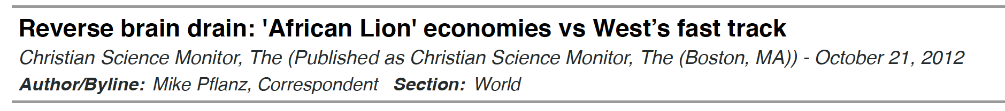
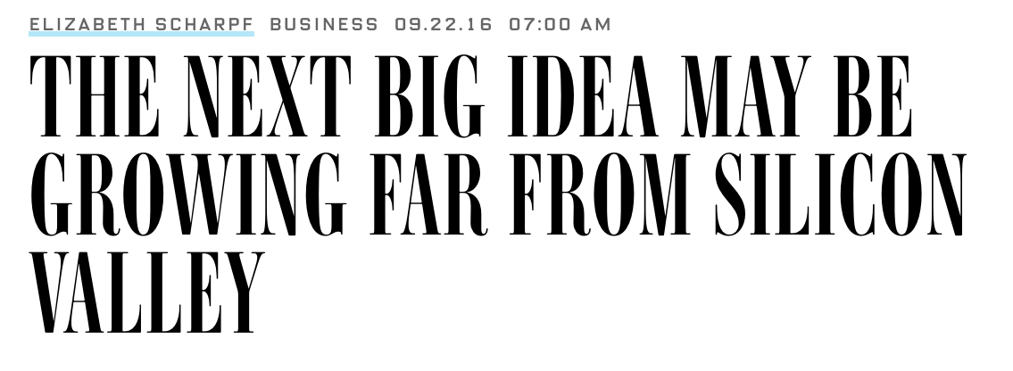
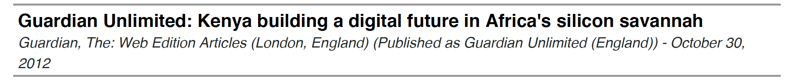
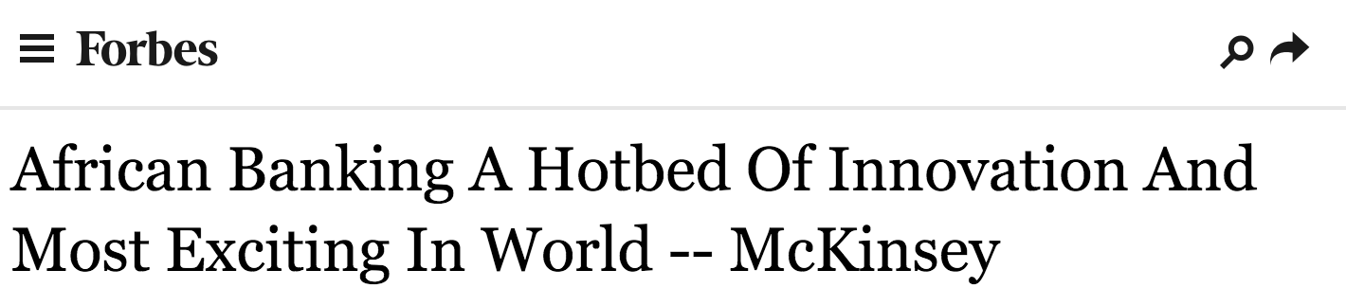
Notes:
Increase in coverage about tech stories 2010 – 2013 – iHub and its members featured prominently in that

Slide 12

Notes:
iHub founders played a clear role in building this narrative

Slide 13
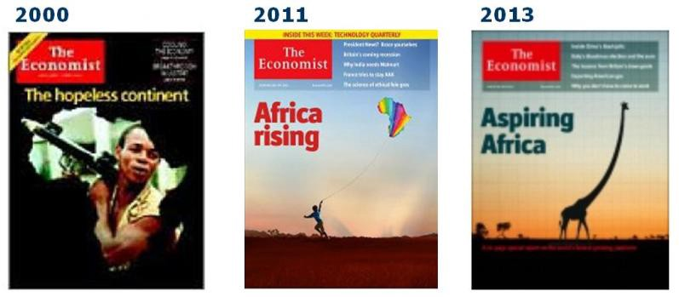
Notes:
Fit into broader narratives
Broader narratives about Africa
AFRICA RISIING NARRATIVE

Slide 14
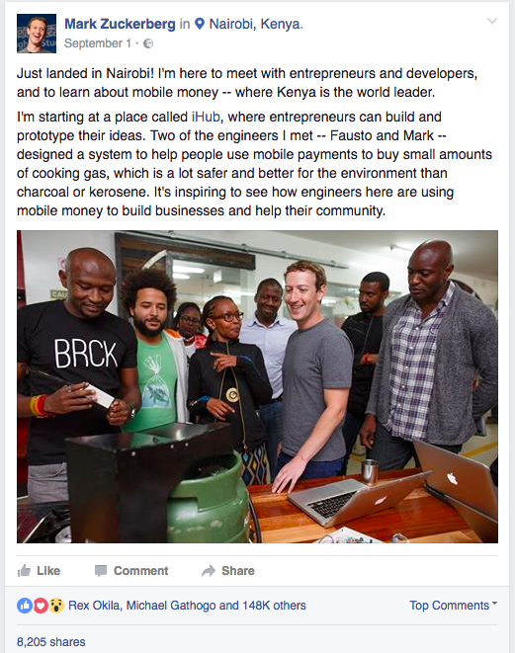
Harrison & Peter
Notes:
Narratives about tech
THE ANYONE ANYWHERE NARRATIVE

Slide 15
“A lot of communication is fitting into existing narratives …it’s easier to sculpt a narrative if you’re already moving with the flow. …if you’re looking for a story in the Africa Rising space, where do you go to find the stories? When you run the iHub, you’re the biggest target to hit.”
- Interview with on of the iHub founders, May 2016
Notes:
iHub founders knew this as well, and purposefully played into the change in global narratives about Africa

Slide 16
Restrictive narratives
Lesson 2: Existing narratives can also restrict through how they shape how your audience sees you
Notes:
Take the example of the entrepreneurs who worked from the iHub. Despite iHub’s success getting attention, many of the entrepreneurs struggled to raise serious investment capital
While the Africa rising narrative was taking off it hadn’t totally supplanted the failed continent narrative – many investors still saw it as a charity case

Slide 17
“Foreign VCs can be difficult here too. They’re not the same as VCs elsewhere. These guys are always asking how something is going to influence the BOP. If it doesn’t influence the BOP? You can’t get funding…They’re social impact investors really. And that makes it hard, you know? They want to fund solar farming or turning waste into energy, they don’t want to fund a B2B venture”
- Kenyan entrepreneur, October 2016
Notes:
How difficult ot is to raise money
During my fieldwork most of investors in the Kenyan space were foreign often bringing with them internalized narratives about Africa as a continent that needed help, in turn looking only at investing in impact starts. But entrepreneurs like Sam were trying to build business facing ventures, something he believed would really help the local economy but something that the foreign investors didn’t want to fund

Slide 18
“Each of us individually are here for the impact. If I want to just make money, there are much easier and much less risky ways of doing that than investing in startups in Africa.”
- Foreign investor, July 2016
Notes:
As a result, many of the entrepreneurs I met had chosen to tell a social impact story and even a social impact business model, because they knew it would more readily appeal to investors
More diverse inviestors, including those from Africa and Kenya coule help aleviate this
And while this clearly comes from a well-meaning place and a desire to “do good”, it is still an approach that sees Africa as a continent in need of help from the “more fortunate” outside, rather than a continent building and shaping its own technological future.
More diverse investors from abroad, as well as the growth of a Kenyan and African investor pool could go some way to rectifying this.

Slide 19
Grounding in truth
Lesson 3: Entrepreneurial storytelling struggles when it is too removed from reality
Notes:
While Trump’s storytelling may be effective even when it’s removed from the truth, I would argue that’s because of the very privledged position he holds
African entrepreneurs are starting from a disadvantaged position
Moreover – in the global practice of tech entrepreneurship, there is immense pressure to tell stories that aren’t YET true
Investors expect to hear what you WILL do and to be inspired
But if it emerges that this is

Slide 20
“When we started saying in 2010: ‘Kenya’s the, you know, tech innovation center of Africa,’ was it true? Eh, arguably, probably not. But it became true, because enough people believed in it and built around it. And said okay, yeah, that can be true.”
- Interview with on of the iHub founders, May 2016
Notes:
The iHub founders are actually forthcoming about how the story the were telling initially wasn’t YET entirely true
And while this helped raise attention for a while
It backfired eventually as some foreign investors stopped coming finding an ecosystem they didn’t think was developed enough
And it backfired with iHub’s own entrepreneurs, who had been promised that Kenya was the tech hub of Africa and anyone could be a successful tech entrepreneur

Slide 21
“There’s no technology coming out of the iHub”
“You have no companies that have gone to the iHub and grown to success”
“What good startup came from the iHub?”
”The iHub is just a hype machine”
Notes:
This discrepancy between truth and the narrative the iHub built led to the emergence
The iHub is still going, but it is not the community hub and powerhouse it once was

Slide 22
THANK YOU!
Dr Eleanor Marchant
Postdoctoral Research Fellow
Centre for Socio-Legal Studies, University of Oxford
@ermarchant
eleanor.marchant@csls.ox.ac.uk

