Slide 1
Startup Journey
On Demand Mobile

Slide 2
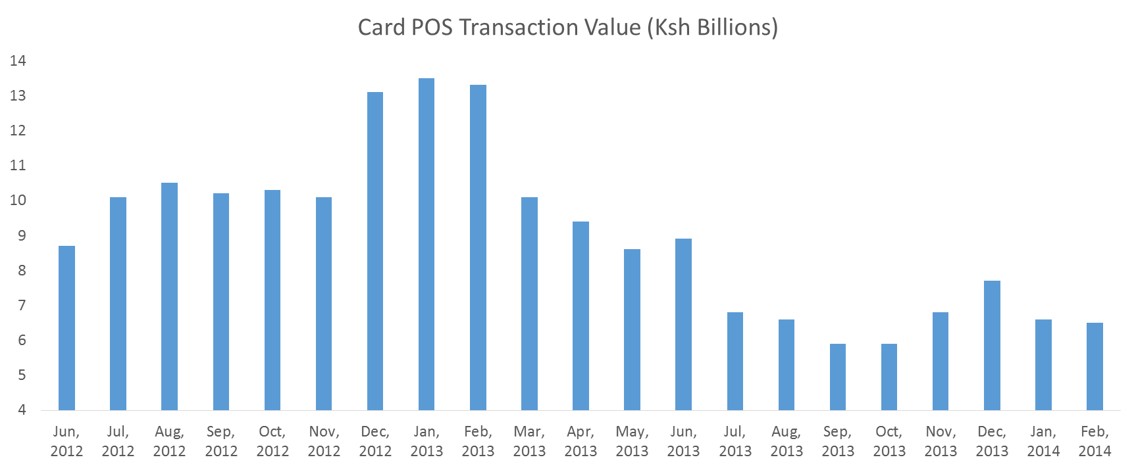
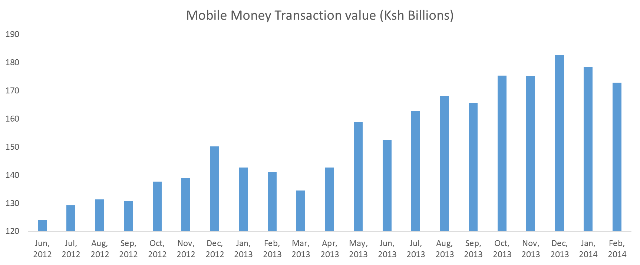
Data
Notes:
2014

Slide 3
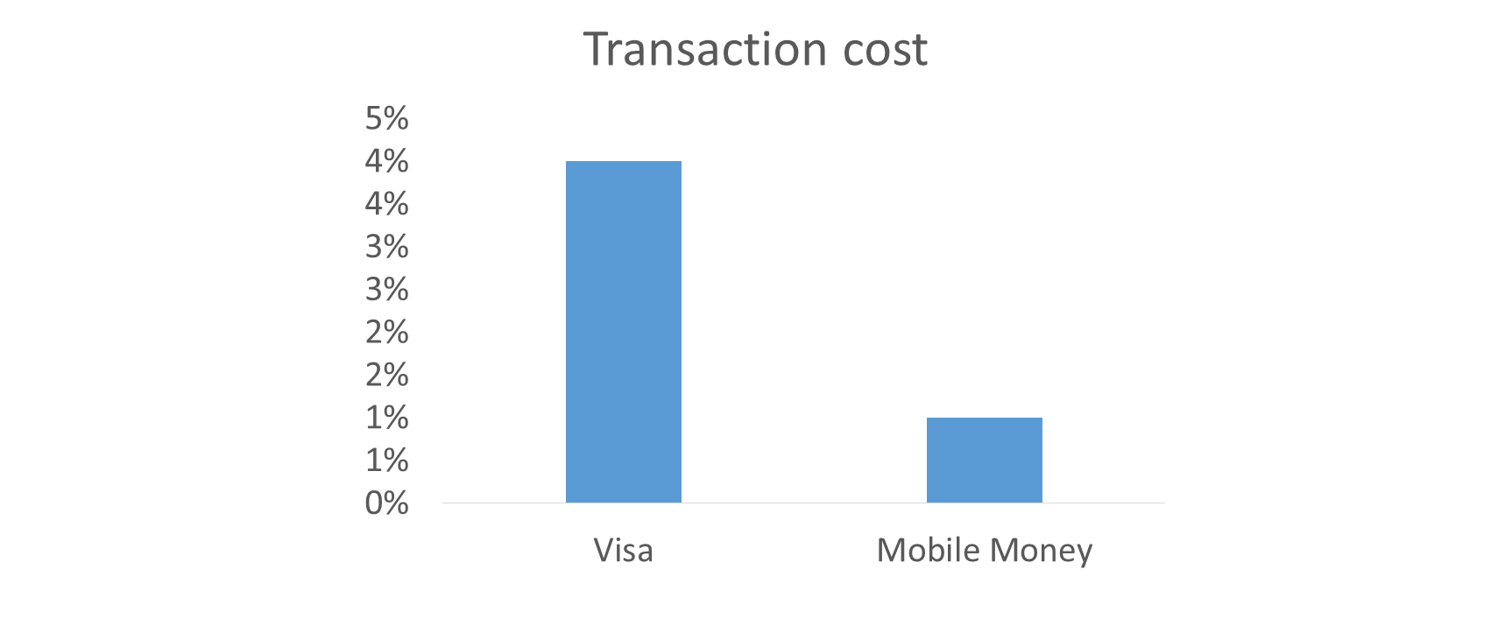
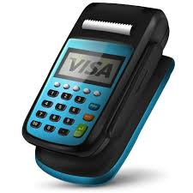
Problem
(1)
(2)
High Cost of Devices
High Transaction fees
(3)
Long Settlement Period

Slide 4
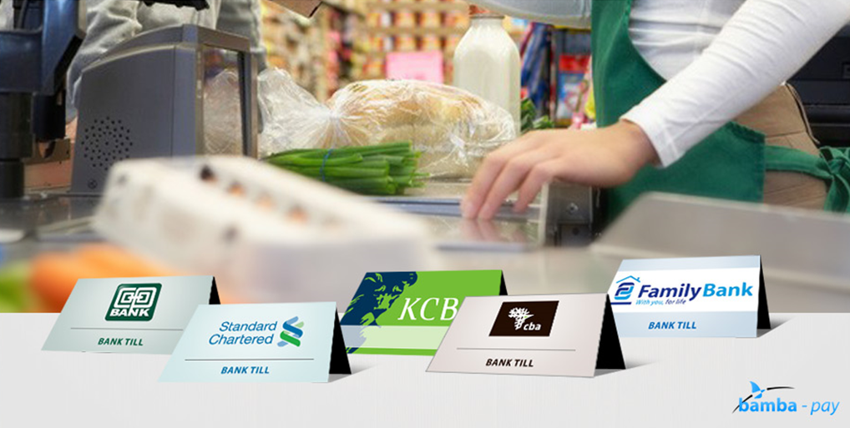
Banking Industry Reaction

Slide 5
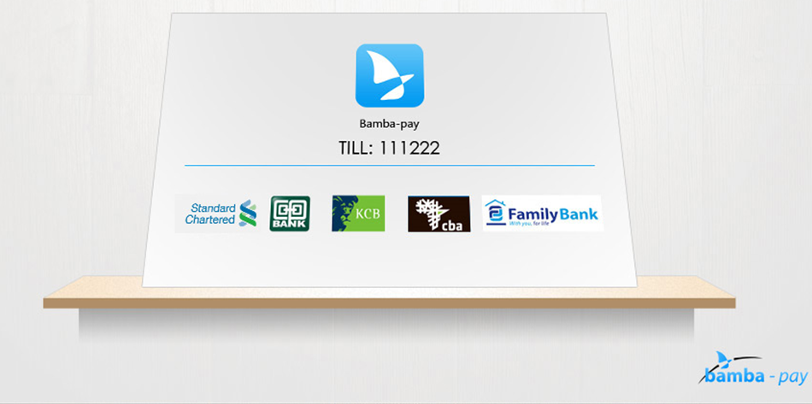
Our Solution

Slide 6
Market Challenges
No buy in from banks. Chicken/egg scenario
Limited Value to merchants
Dropping transaction fees
New market entrants
Significant scale required/high volumes

Slide 7
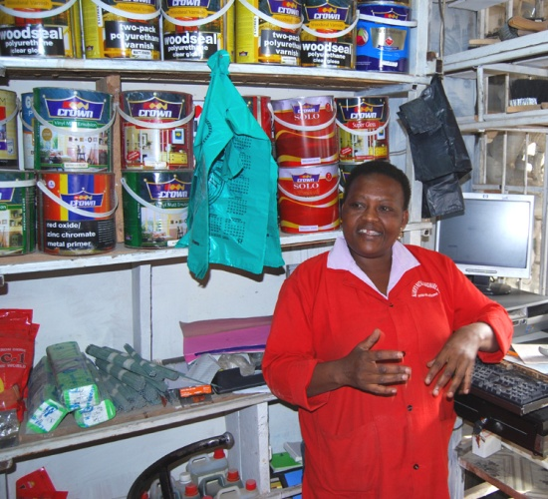

Retailer Interviews

Slide 8
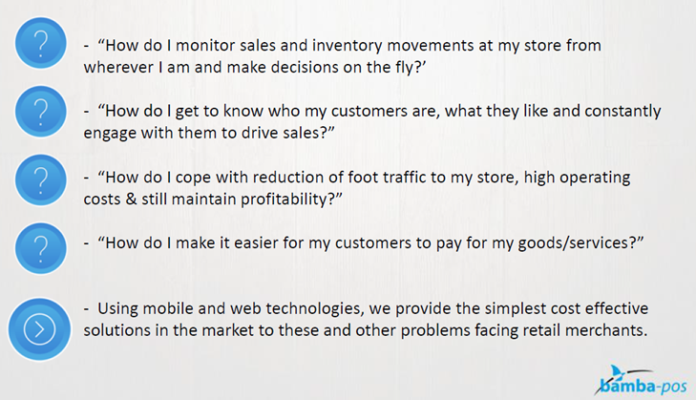
Help Retailers Make Data Driven Decisions

Slide 9
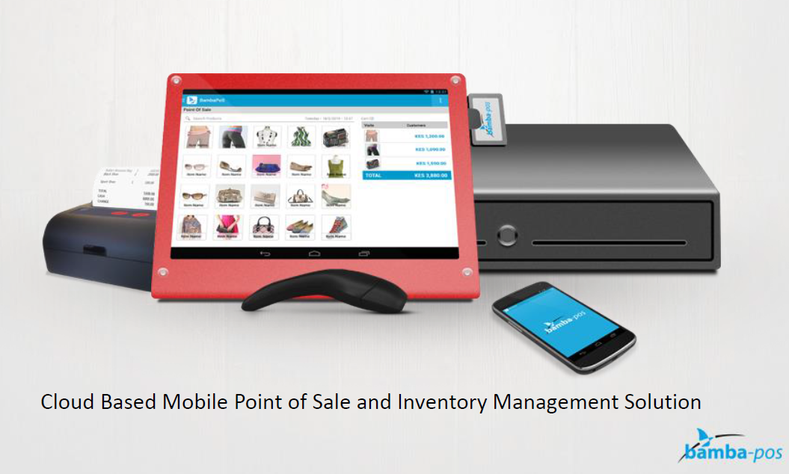
Bamba POS

Slide 10
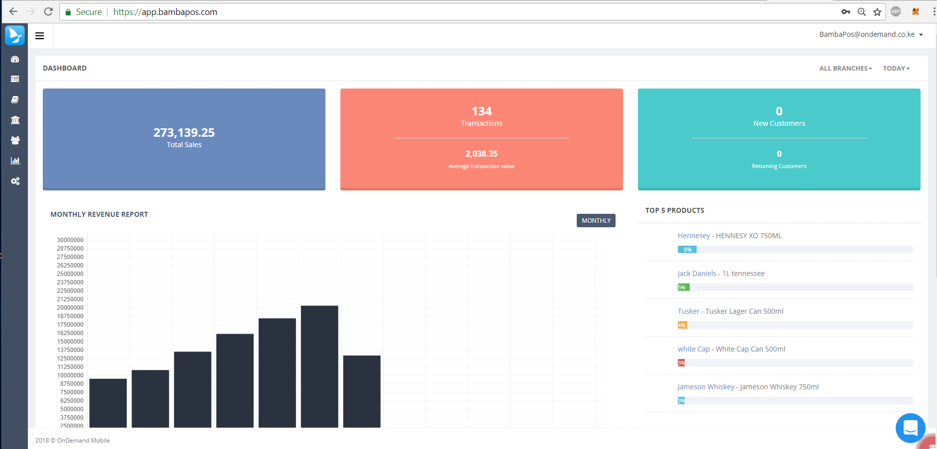

Slide 11
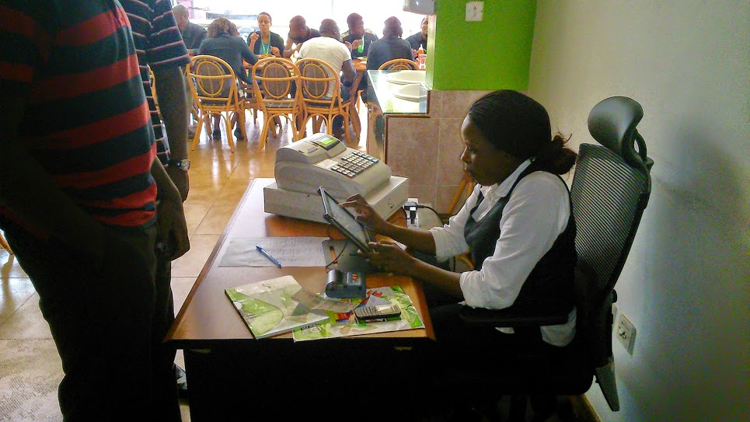
Safaricom Cafeteria

Slide 12
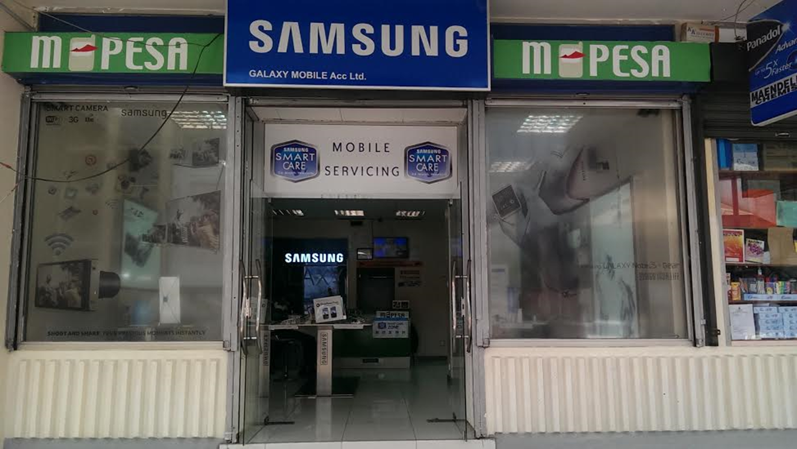
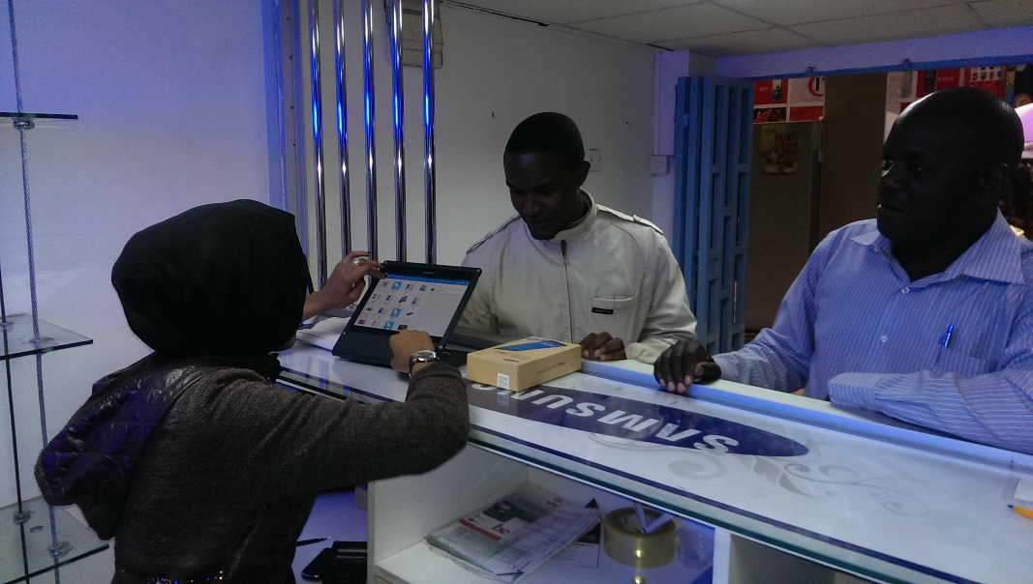
Samsung Galaxy Traders

Slide 13



Traction
60 Active Merchants

Slide 14
Challenges
Lack of Capacity
Long sales cycle
Hardware compatibility
Tedious Onboarding
Lack of focus
Limited marketing
Ego/overconfidence
Entrepreneur fatigue
Team conflict
Lack of focus (individuals)

Slide 15
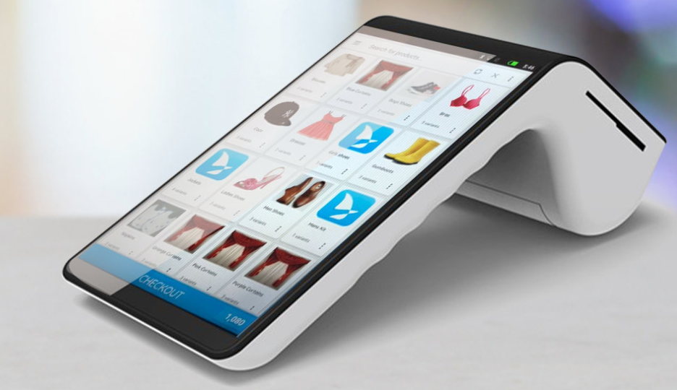
Where we are Now

Slide 16
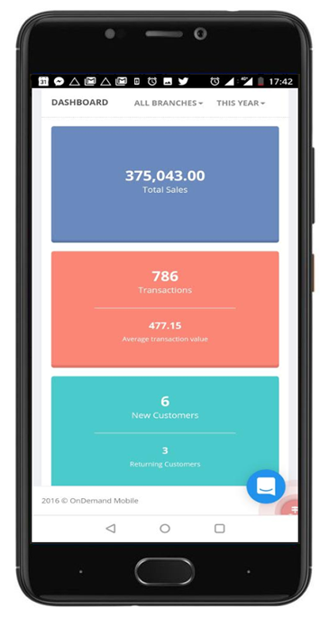
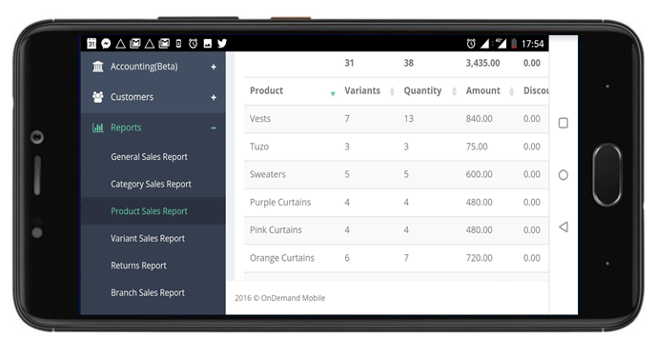

Slide 17
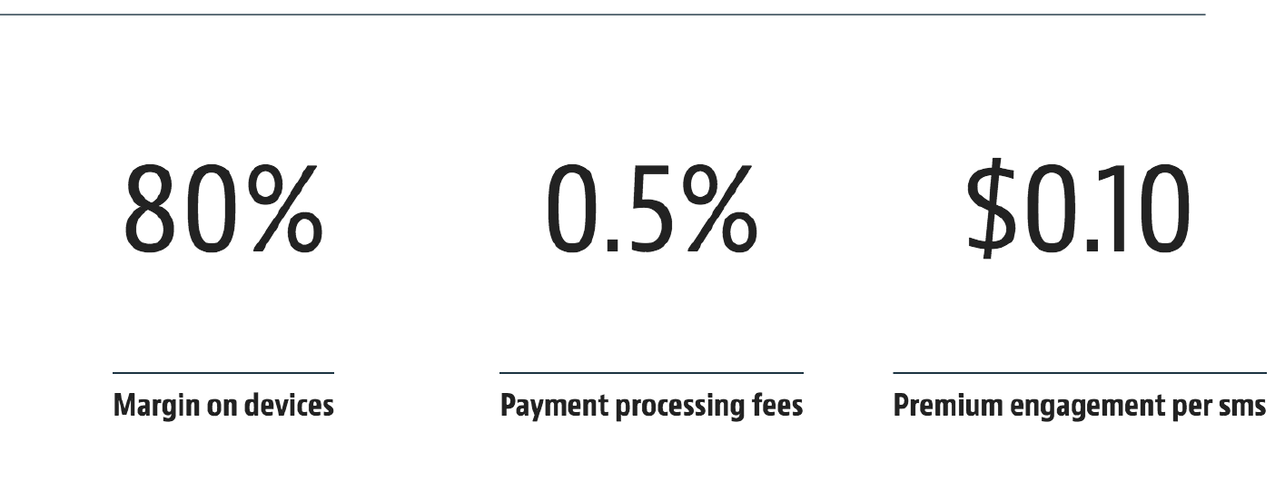

Business Model
Future Revenue from credit scoring and merchant lending

Slide 18
Challenges
Slow product development (Dev Capacity)
Funding – No mans land
Hardware (KRA integration)

